Slide 1
X-ray Scattering: Liquid Metal/Vapor Interfaces
P.S. Pershan
SEAS & Dept of Physics, Harvard Univ., Cambridge, MA, US
X-ray Liquid Surface: Experimental
Variety of Liquid Metal/Vapor Interfaces
Open questions on surface freezing of liquid metals
Notes:
Redesign: New thing is experimental

Slide 2
Our Group.
Colleagues (~20 years)
Balagurusamy, V. S. K. Berman, E. Deutsch, M. DiMasi, E. Fukuto, M. Gebhardt , J. Gog, T. Graber, T. Grigoriev, A. | Huber, P. Kawamoto, E. H. Kuzmenko, I. Lin, B. H. Magnussen, O. M. √√Mechler, S. Meron, M. Ocko, B. M. Pontoni, D. | Regan, M. J. Sellner, S. Shpyrko, O. G. Steimer, C. Stoltz, S. Streitel, R. Tostmann, H. √√Yahel, E
Harvard, Non-Harvard, Beam Line

Slide 3
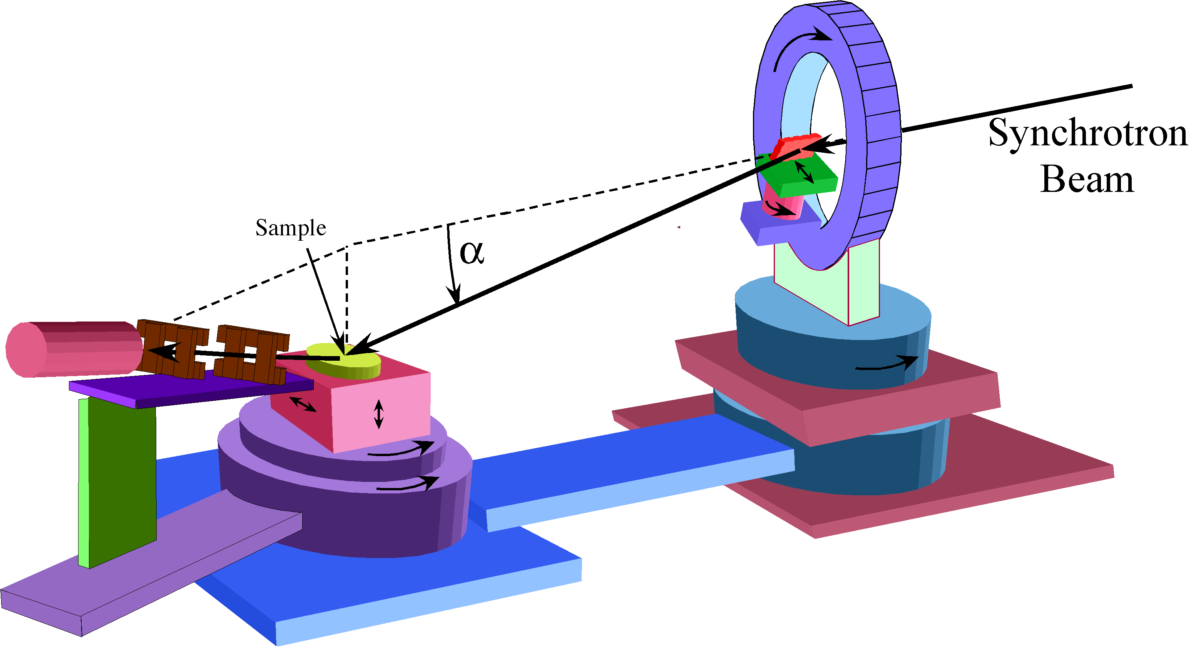

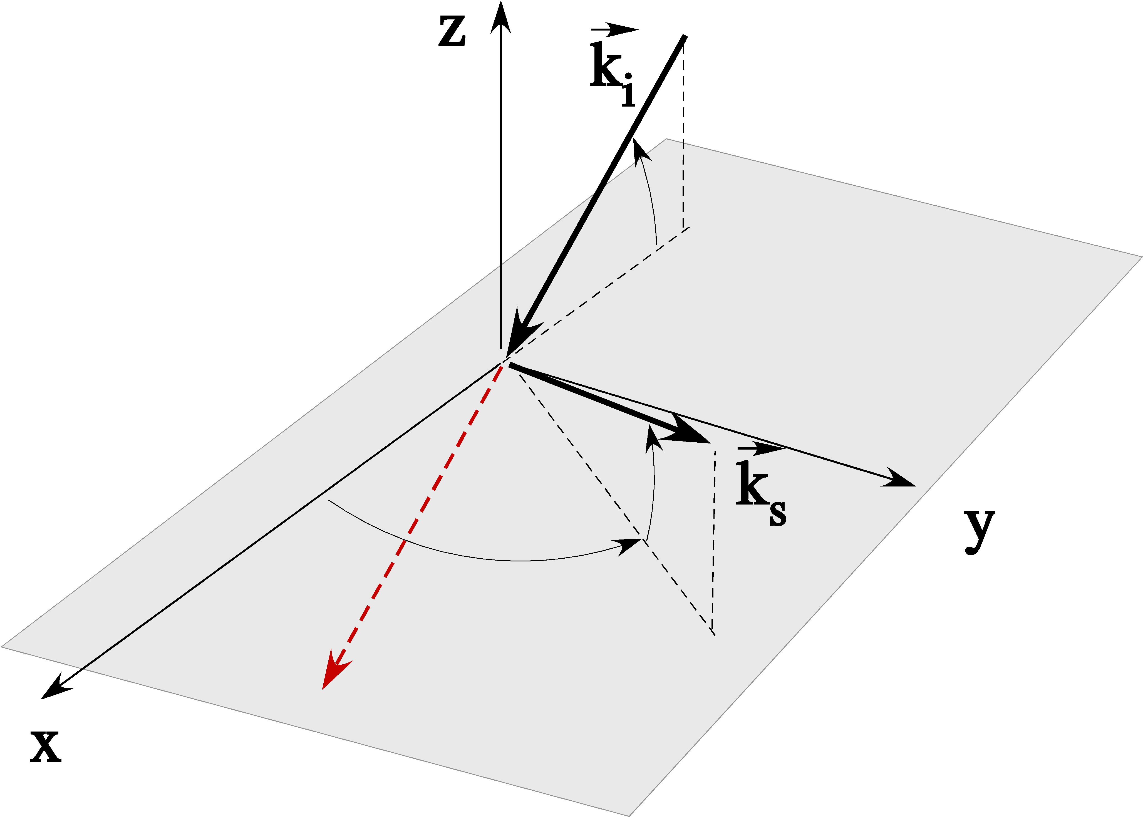
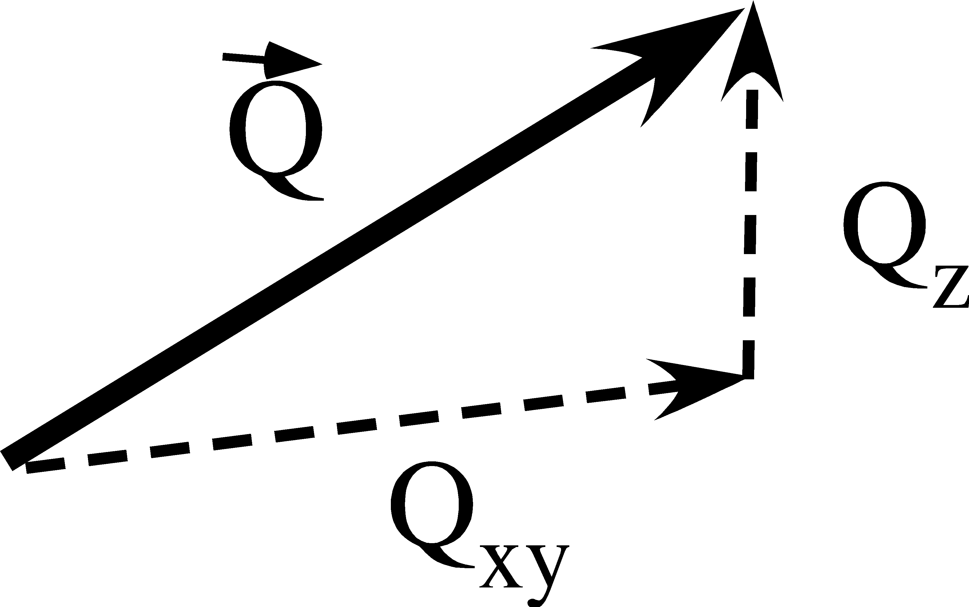
Liquid Surface Reflectometer
1982: Hasylab
1986: NSLS
2002: APS
Q

Slide 4
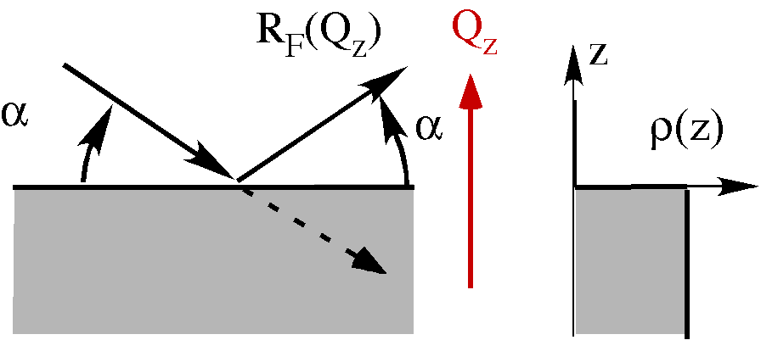
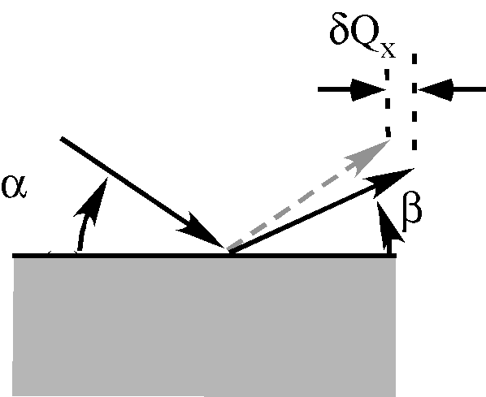
Fresnel X-ray Reflectivity
Diffuse scattering:

Slide 5
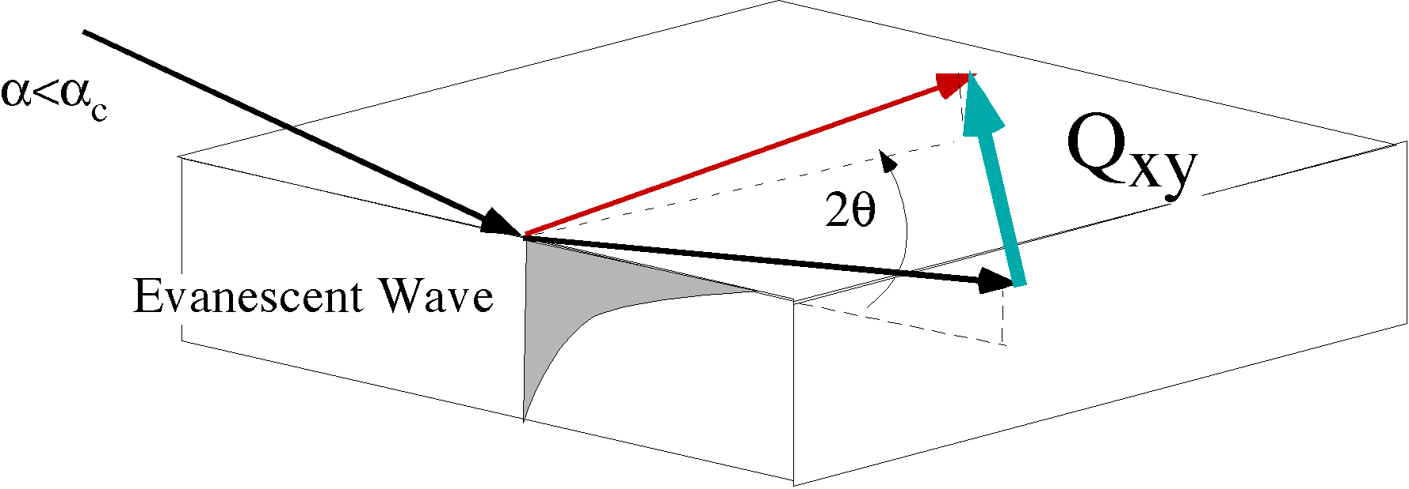
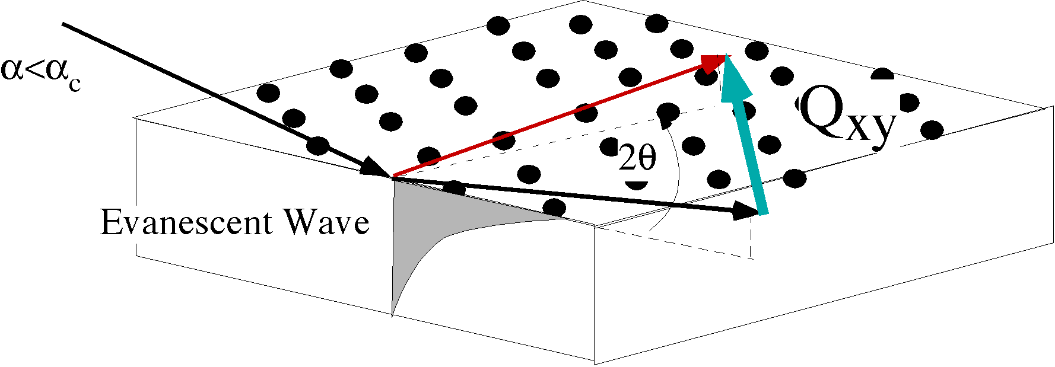
Grazing Incidence Diffraction
(GID)
Diffuse Scattering at Larger
2D Bragg Peaks

Slide 6



Real Liquid Surfaces
Surface Structure
Thermal capillary waves
Reflectivity
Diffuse
Scattering

Slide 7

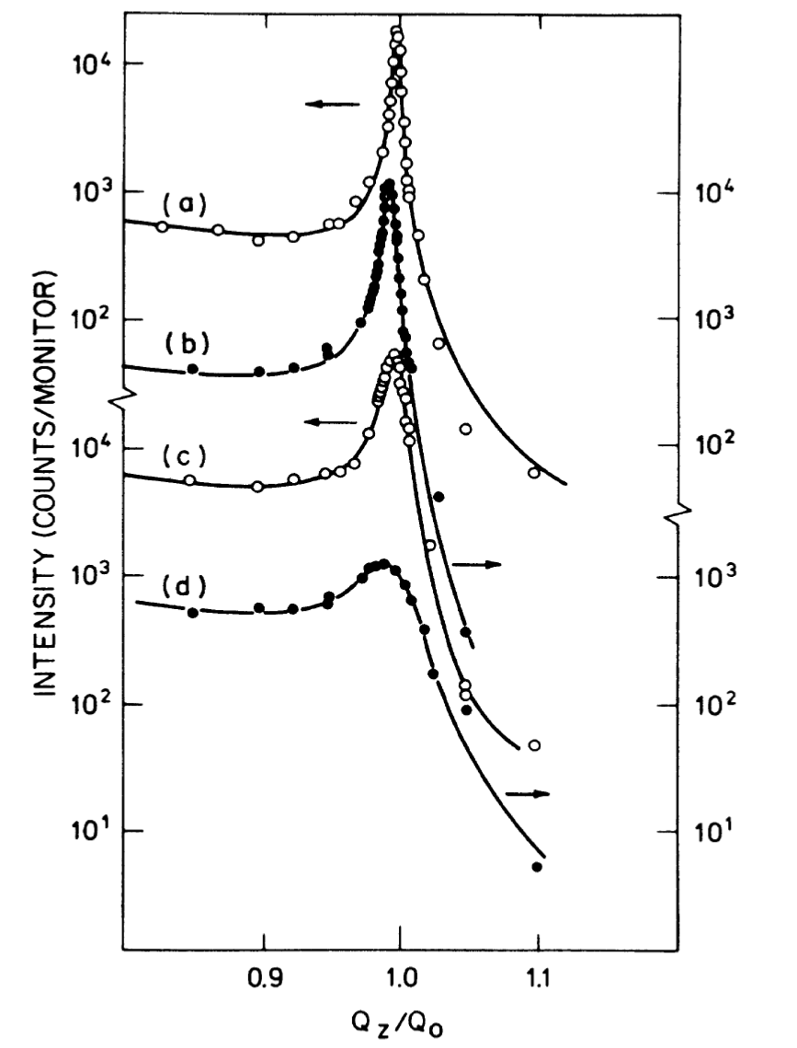
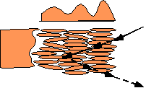
Surface Structure Factor
Surface Roughness (atomic scale)
Molecular Size
a
Liquid
Crystals
1982
Dielectric Liquids
Notes:
Text does not need to “appear”

Slide 8
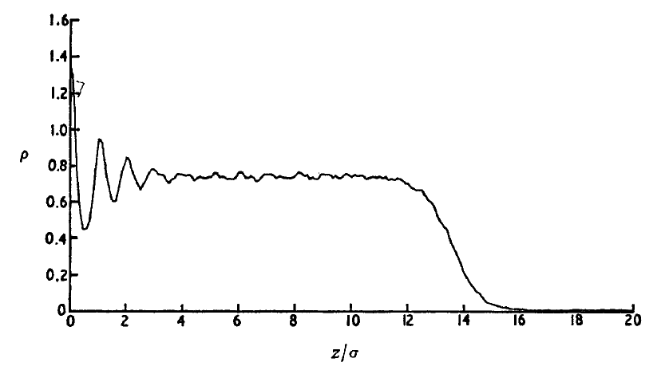
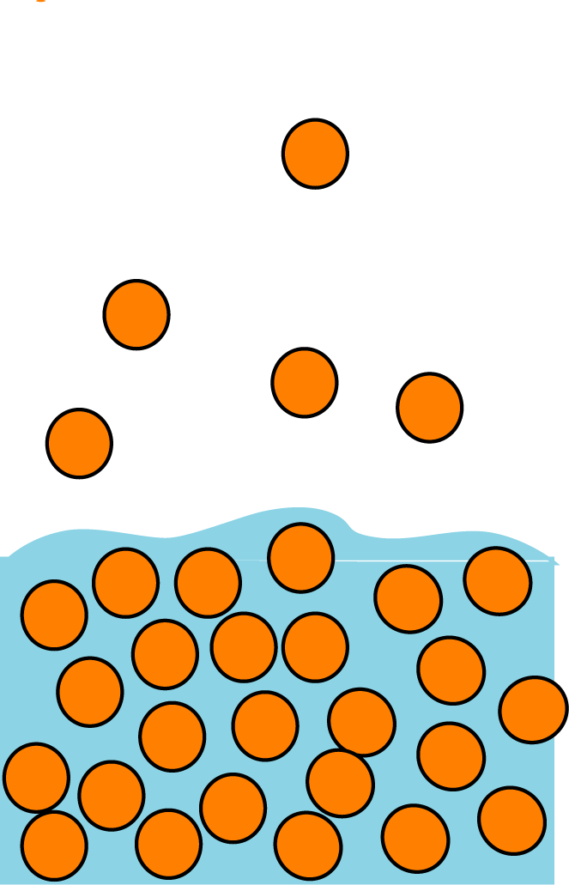
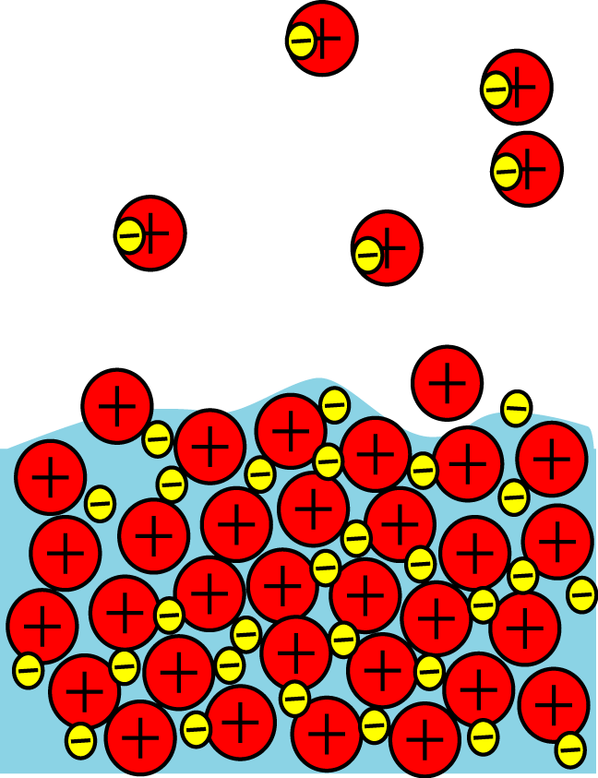
Free Surfaces of Non-Metallic vs Metallic Liquids(Layered)
Simuation (Lennard-Jones
Non-Metallic Liquids)
D'Evelyn & . Rice, J. Chem. Phys., 1983.
For Metals Particle-Particle Interactions
Change Across The Surface
Dielectric Liquids
Metallic Liquids
Vapor: Neutral Atoms
Interactions are Same in Vapor and Liquid
Different Interactions
Liquid:
Positive Ions in Sea of Negative Fermi Liquid
This induces Layer Structure of LM Surface!
Goal: Measure Intrinsic Surface Structure Factor

Slide 9
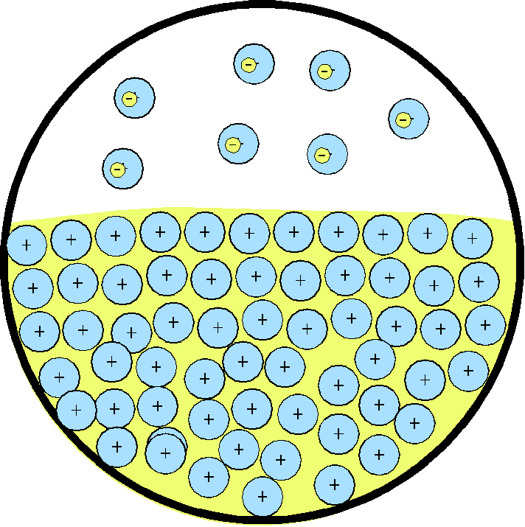
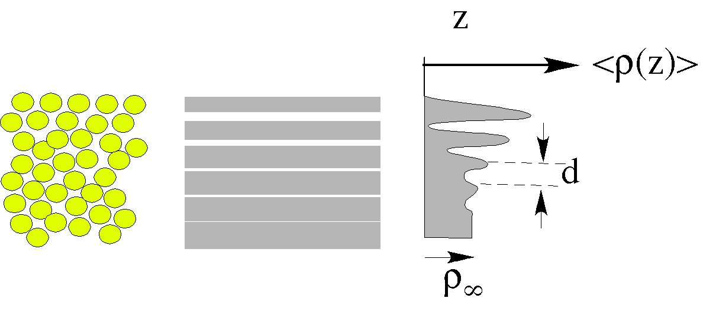
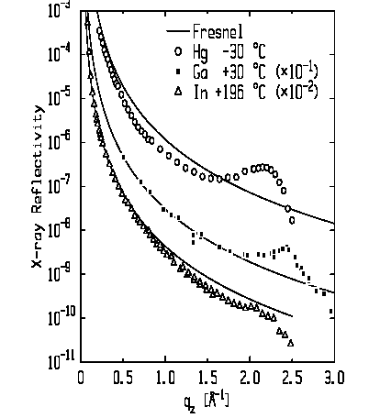
Type I: Elemental Liquid
Layer Response of Bulk Susceptibility
Metallic Liquids (D’Evelyn & Rice ‘83)
Hg
Ga
Hg: Magnussen et al. (1995).
Ga: Regan et al.(1995)
In: Tostmann et al.(1999)
In

Slide 10
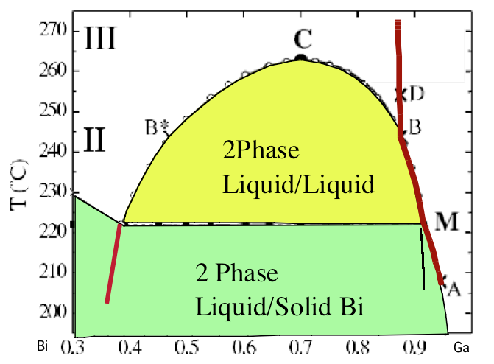
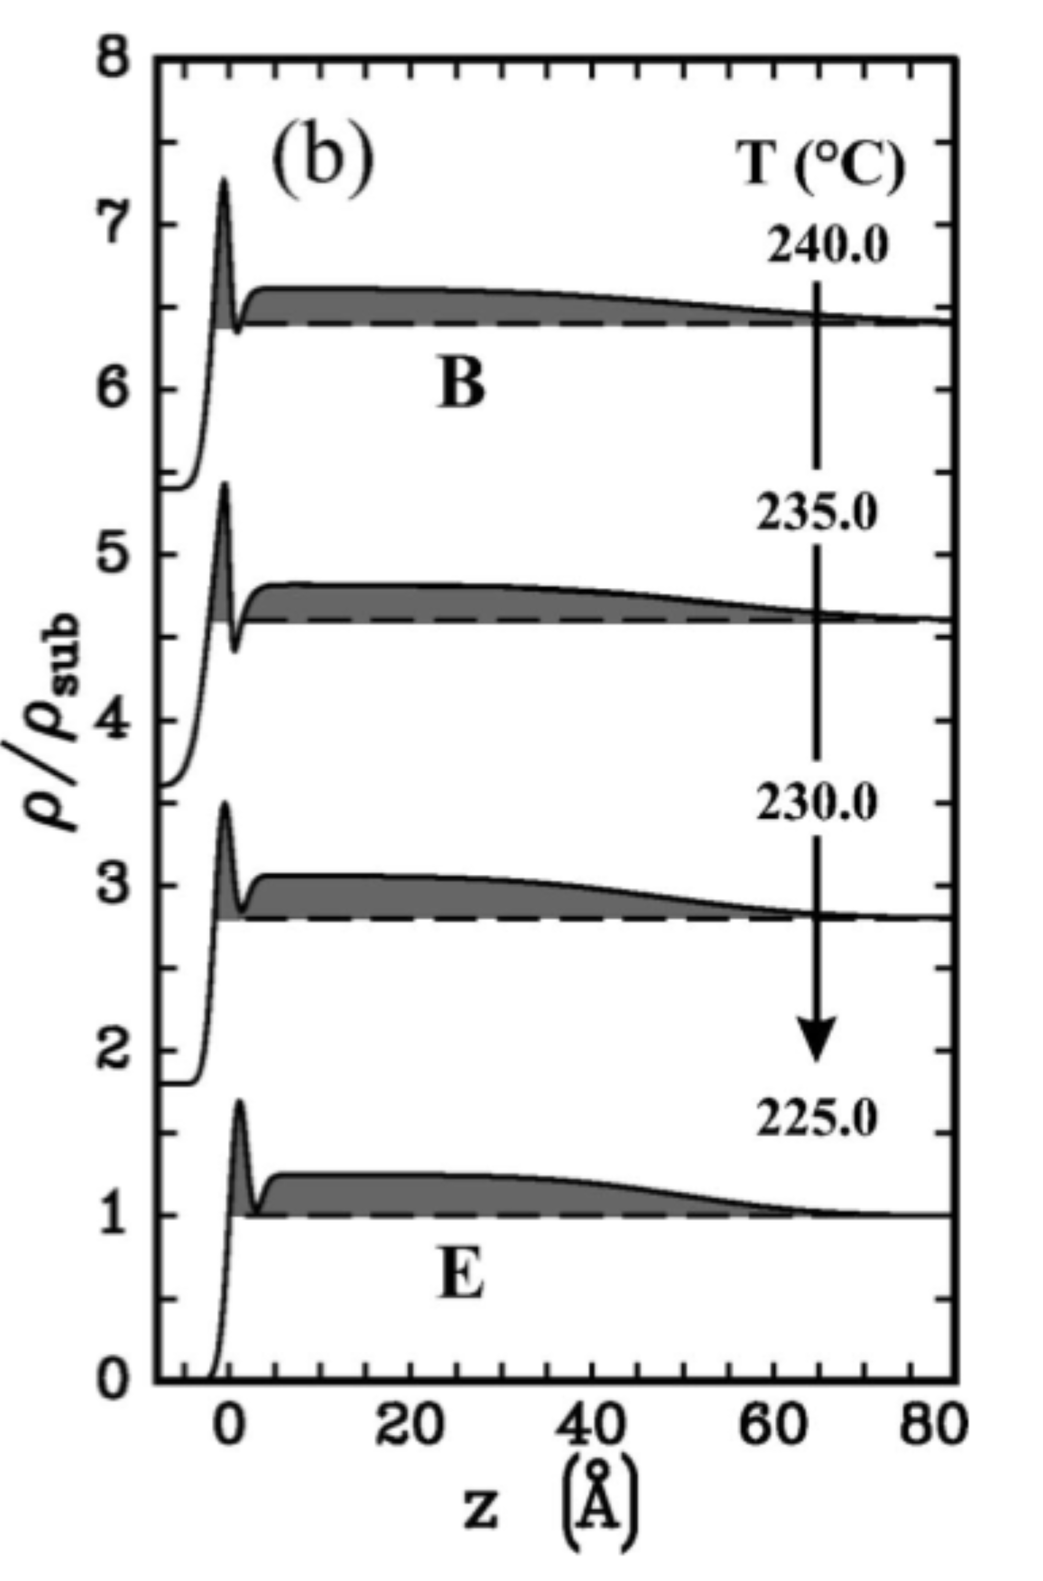

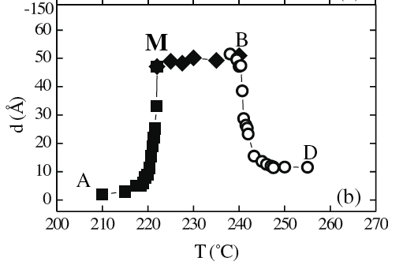
Type II: Surface Adsorption(Ga-Bi alloy)
Bulk Phase Coexistence
Gibbs: < 1900
Butler: ’35
Egry: ‘05
Nattland &Freyland, ’94
Chatain & Wynblatt, ‘96
P. Huber,’03
Electron Density
d vs T
d
Calphad Initiative(data)➔Gibbs free energy density:
Influence Parameter:
ξ
Surface Tension

Slide 11
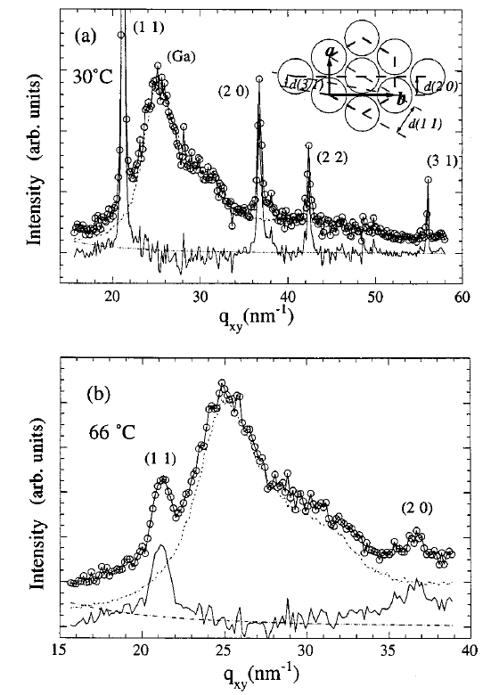
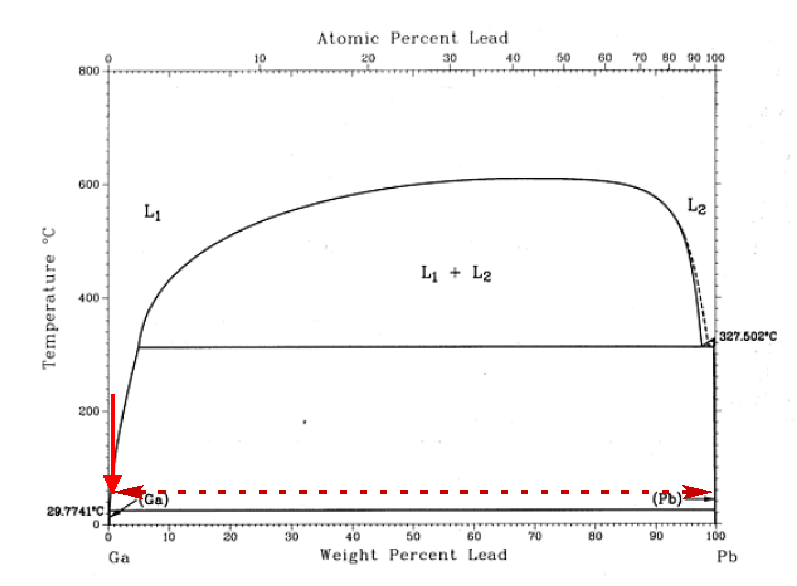
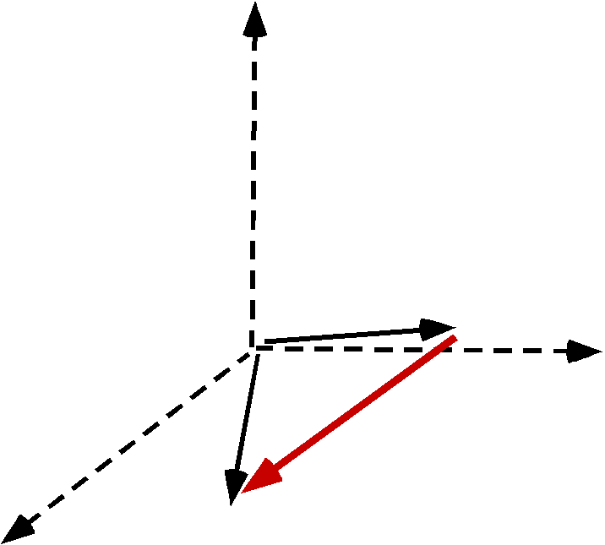
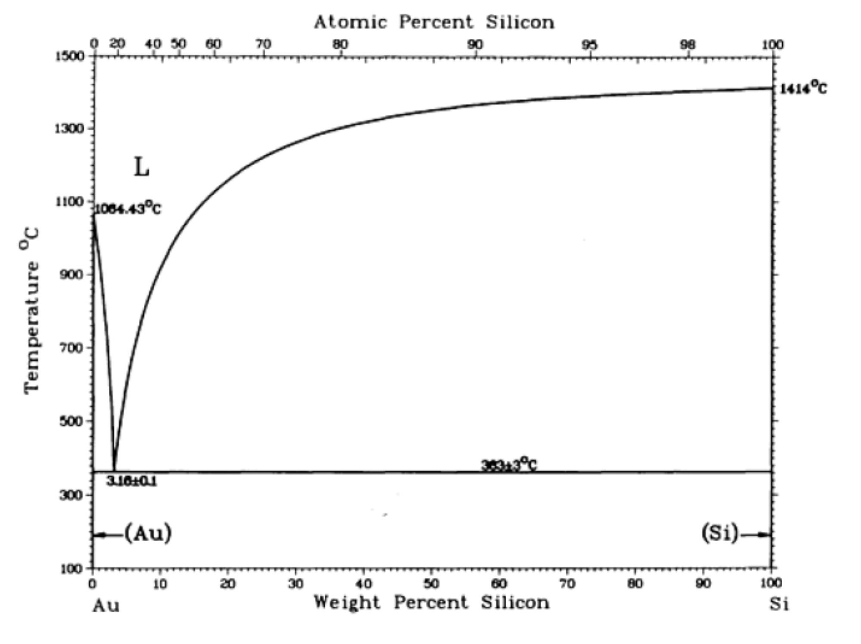
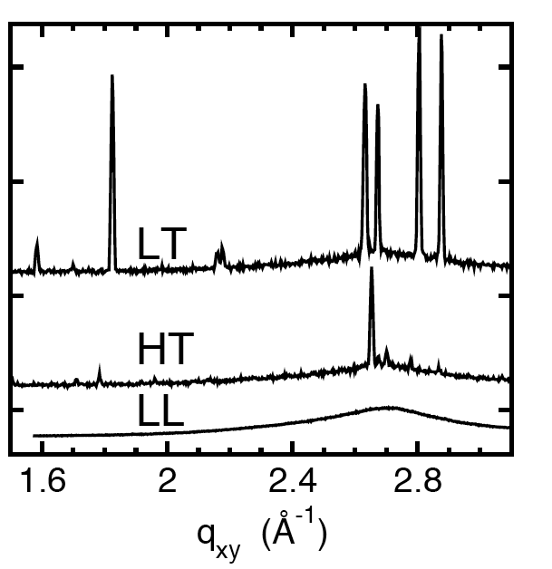
TypeIIIa: Surface Phase Transition
2 Phase Binary Solution
Yang et al. PRB. 62, 13111 (2000)
Gibbs Adsorption
Pb-monolayer on Ga
2D Crystal.
GID Scattering
Au-Si Eutectic
Shpyrko et al. Science 313, 77 (2006) vol. 313 (5783)
Mechler et al. PRL (sub 2010)
2D Au-Si Crystals
+Layer
Bilayer
Monolayer
Liquid
Is this Gibbs?

Slide 12
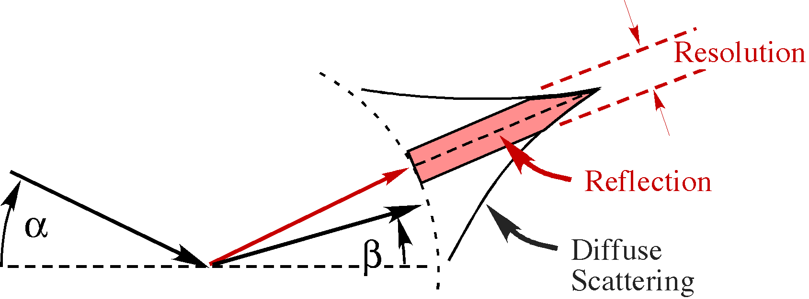
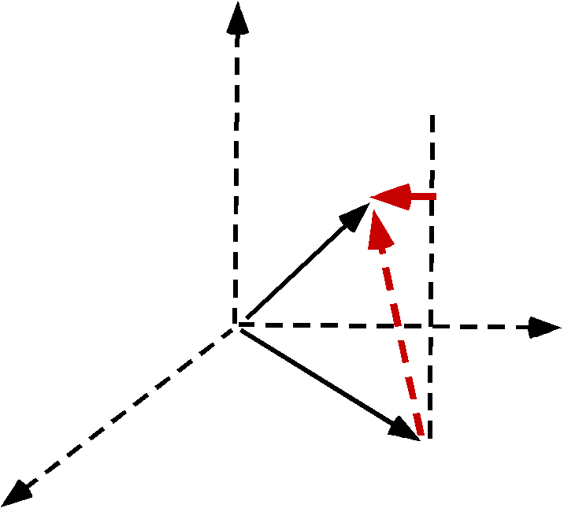
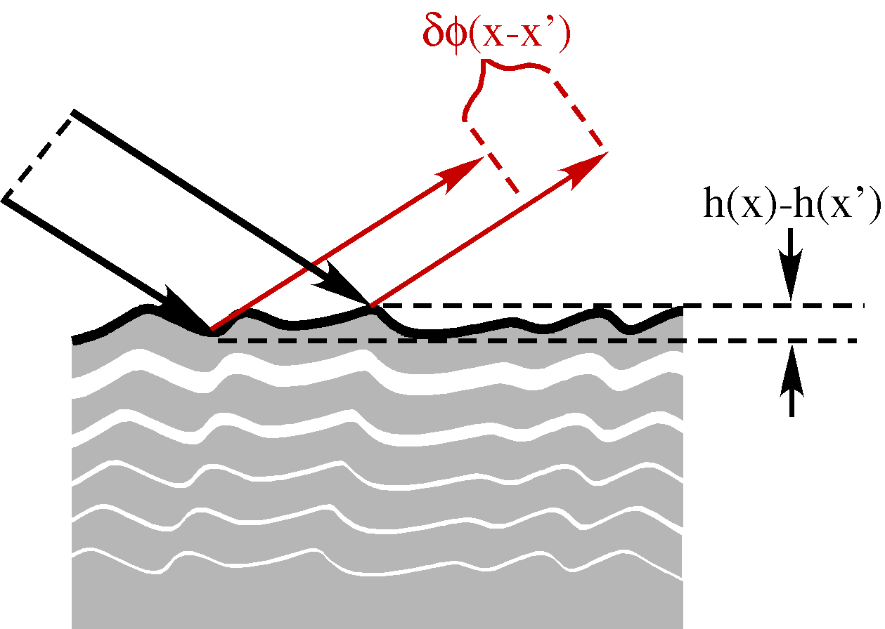
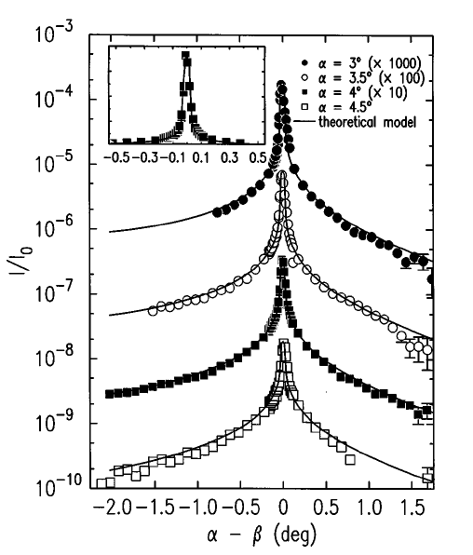
Structure Factor &Thermal Effects
Debye-Waller⬅➔Capillary Waves
Diffuse Scat: In
2D
Debye-Waller
~0.01Å⁻¹

Slide 13
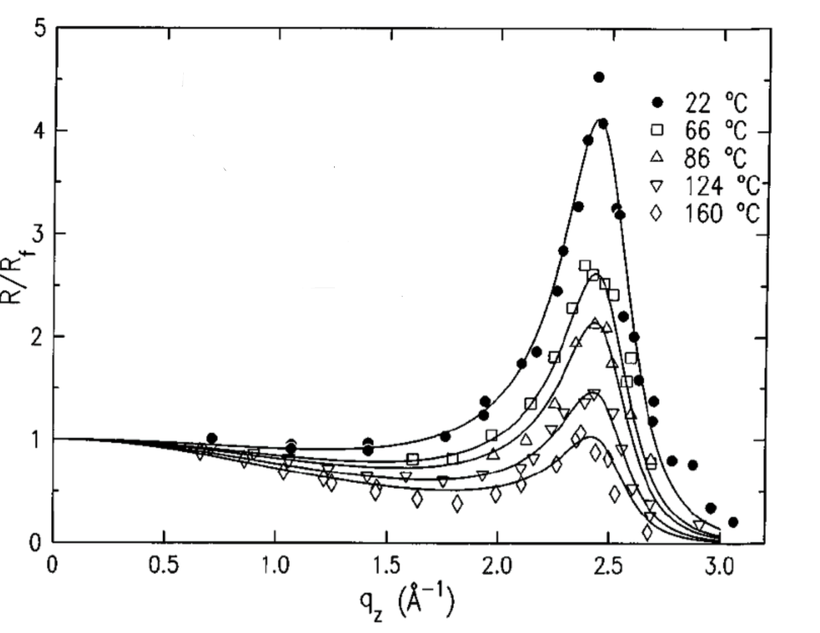
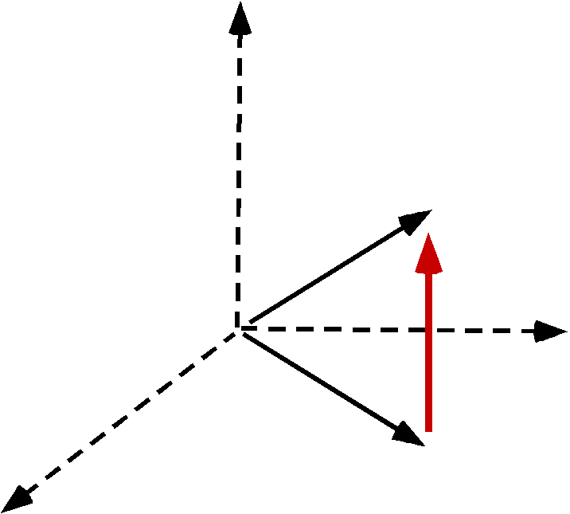
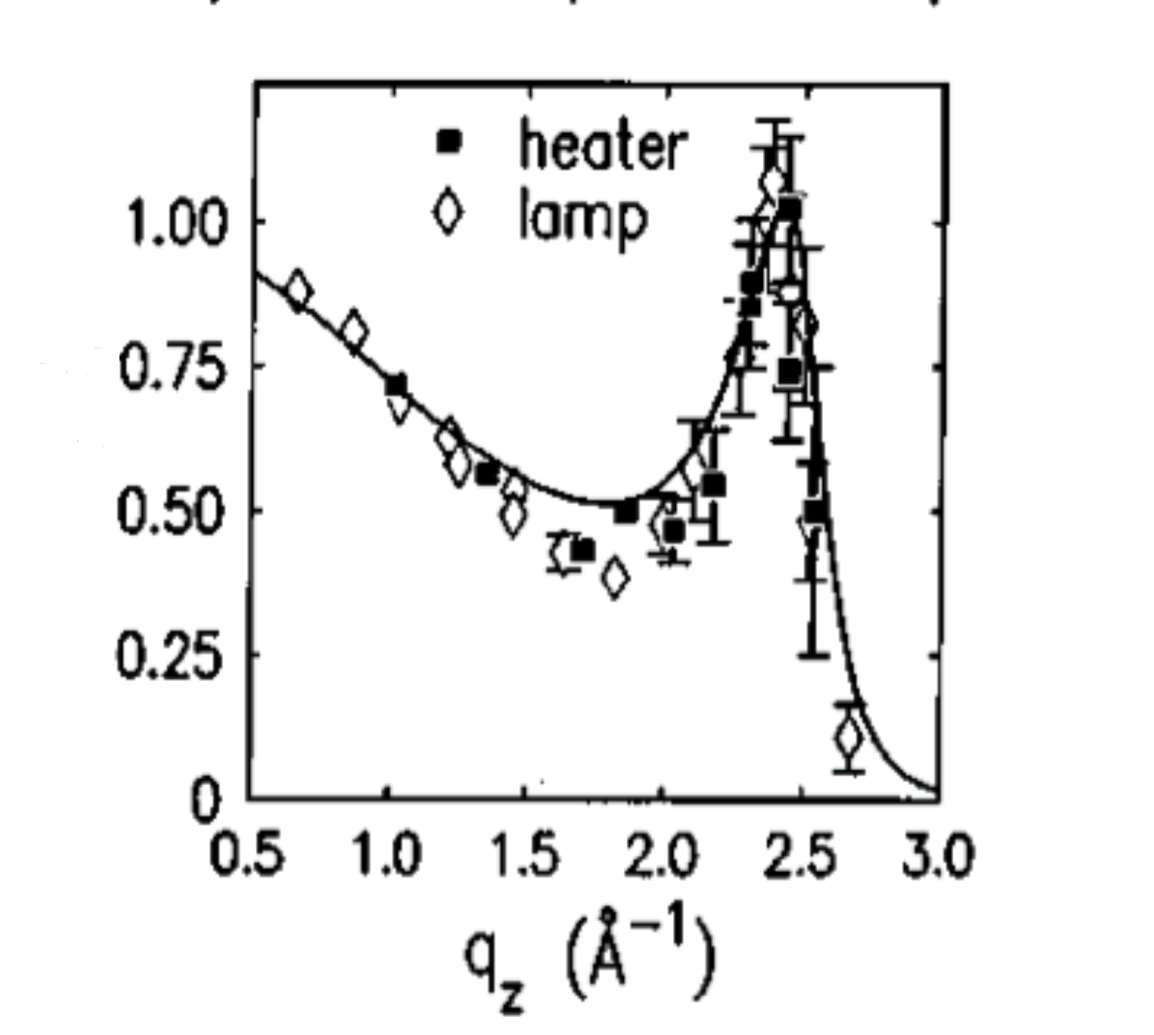
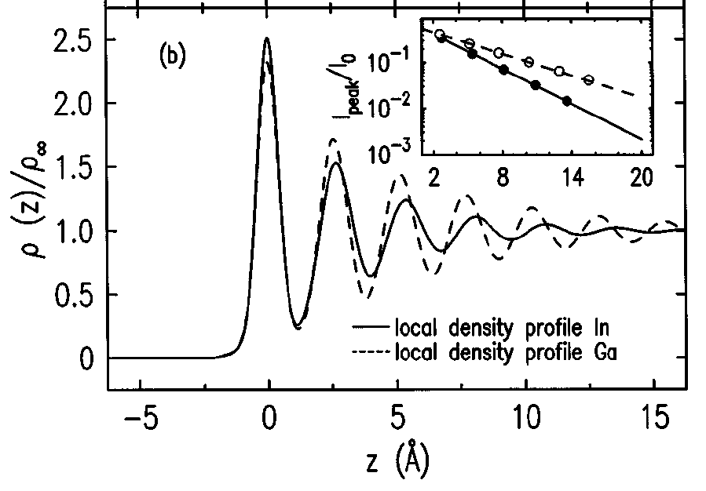
Debye-Waller Demonstration
Ga vs. T
Hg
Ga
Ga
In
In
Ga
In

Slide 14
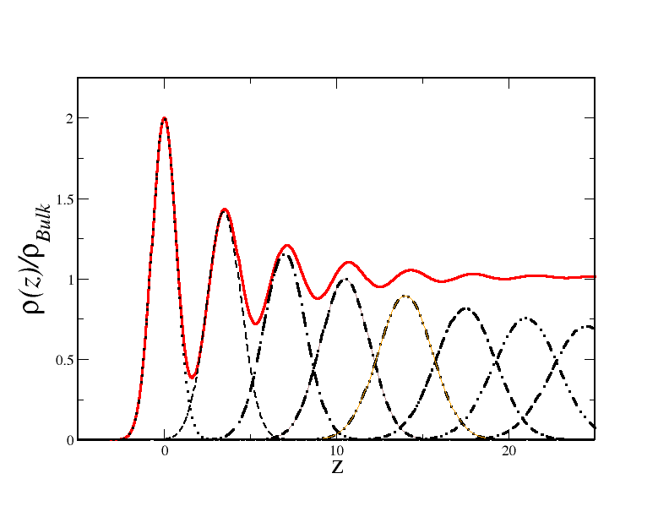
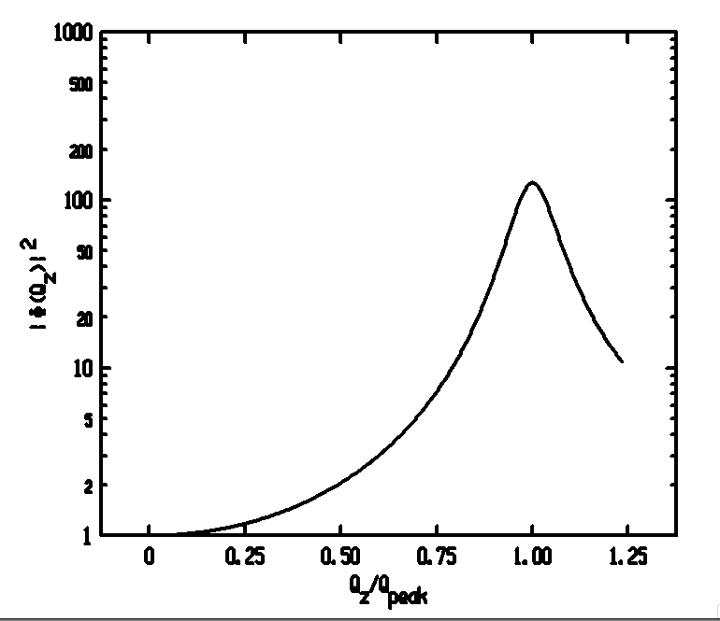
Distorted Crystal Layer Model
DCM (Magnussen ’95)
Only 3 Adjustable Parameters
n=0 1 2 3 ...

Slide 15
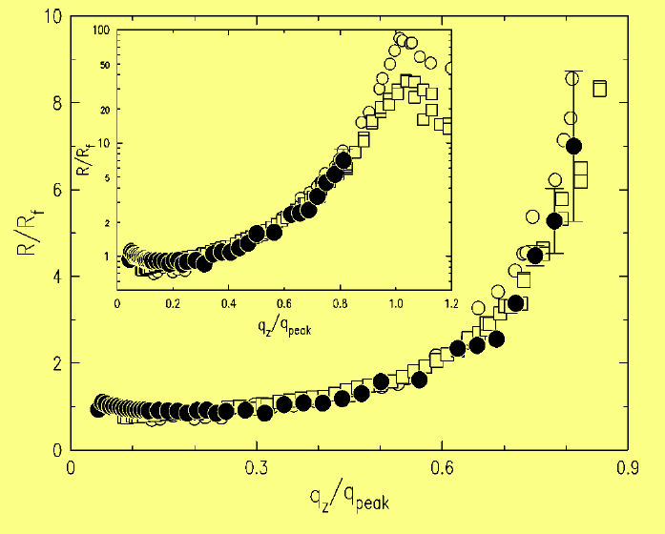
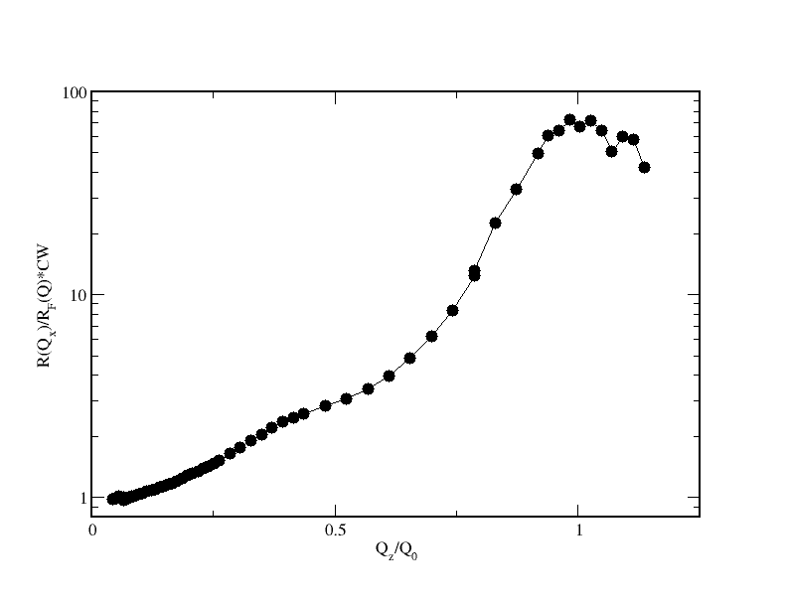
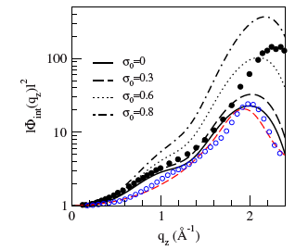
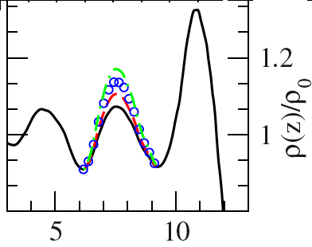
Elemental Liquid Metals Studied
K | Ga | In | Sn | Bi | Hg
DCM | DCM | DCM | +1 | +1 | ?
• | ○ | ☐ | • | ☐
Sn
No Bump⬅➔Bump
Why are 1st Layers for Bi and Sn different from K, Ga and In?
Mol. Dynamic. Simulations
Calderín et al.
PRB,80,115403 (2009)
Bi is like Sn! Why is Hg so different?

Slide 16
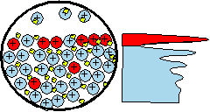
Eutectic Alloys
J. W. Gibbs <1900
Surface Adsorption: A/B Alloy
If Surface Tension: γ_{A} > γ_{B} Surface is Rich in “B”.
A_{x}B_{1-x} | γ(A)/γ(B) | ΔH* (mixing) | Concentration of Surface Layers
 |  |  | 1st | 2nd | 34d
Ga_{x}Bi_{1-x} | 718/378=1.90 | +4 | Liquid-Liquid Phase Sep.
Ga_{83.5}In_{16.5} | 718/556=1.29 | +5 | 97%In
In₇₈Bi₂₂ | 556/378=1.47 | -1 | 35%Bi
Sn₅₇Bi₄₃ | 560/378=1.48 | +1 | 96%Bi | 25%Bi | 53%Bi
Au₇₁Sn₂₉ | 1100/560=1.96 | -10 | 96%Sn | <1%Sn | 24%Sn
Au₇₂Ge₂₈ | 1100/621=1.77 | -21 | No Gibbs Adsorption
Au₈₂Si₁₈ | 1100/865=1.27 | -30 | 4-layers, 2DXtal (AuSi₂)
Pd₈₁Ge₁₉ | 1500/621=2.4 | -44 | ~40 Å wetting layer (No Measureable Gibbs Adsorption)

Slide 17
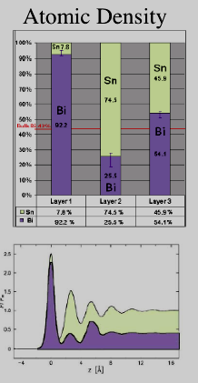
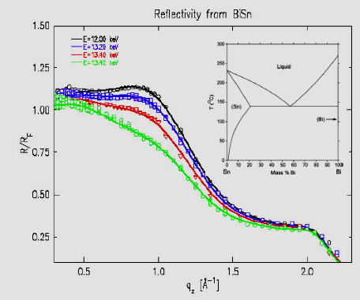
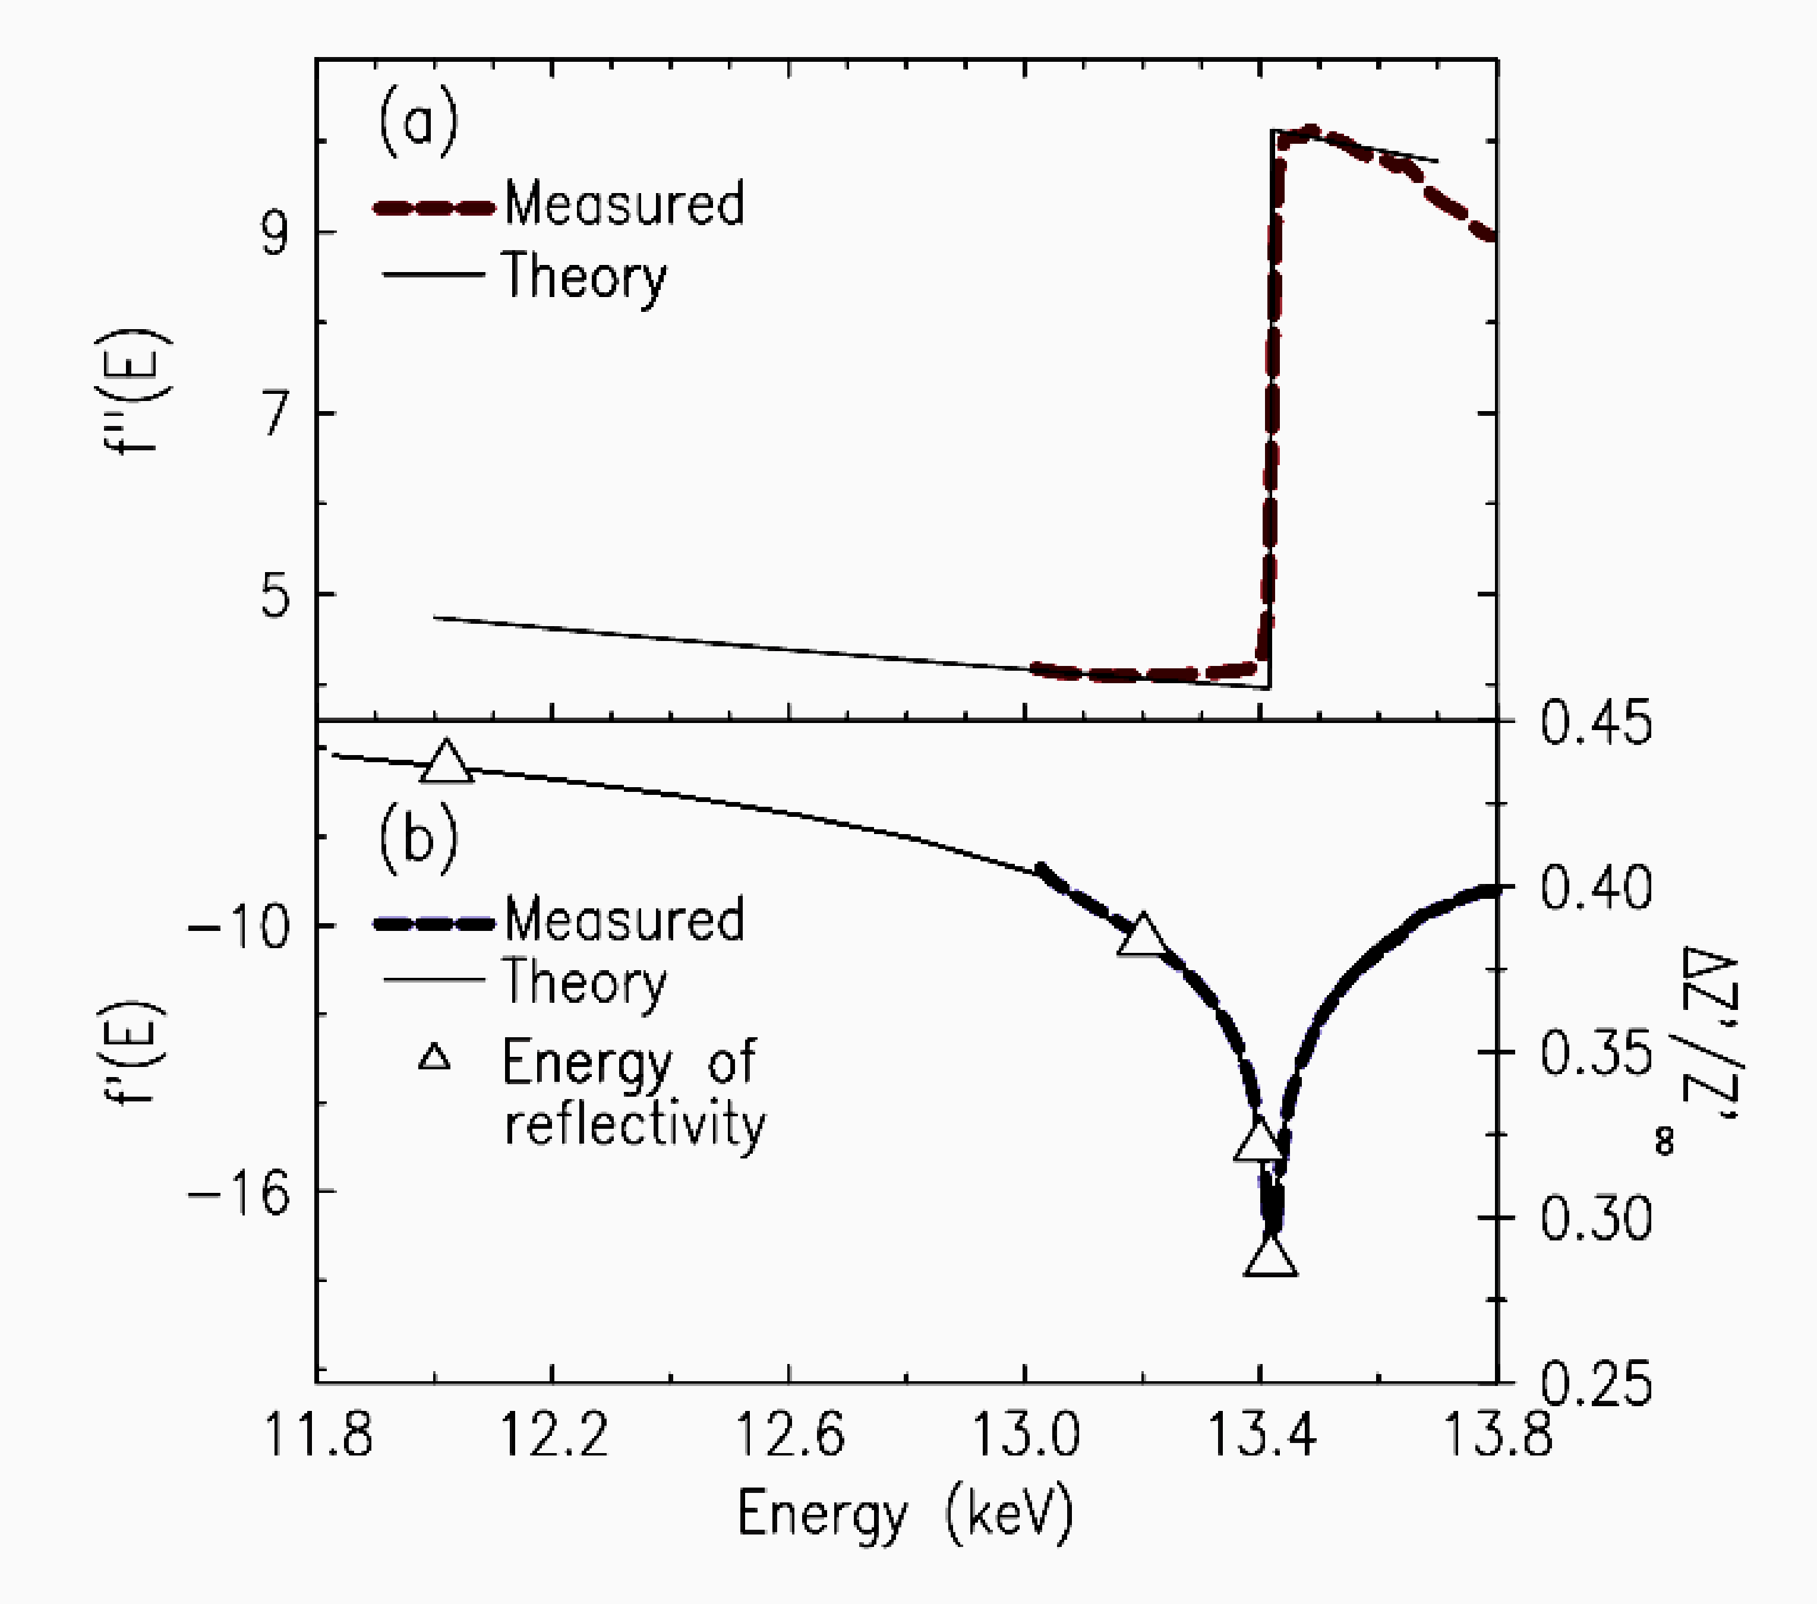
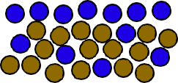
Gibbs Surface Adsorption(BiSn)
Alloy: Bi and Sn
γ_{Bi}=378, γ_{Sn}=560,
Energy Dispersion:
Bi:L3 f(E)
Adsorption
Scat. Ampl.
γ(Bi)≈ 398
γ(Sn)≈ 567 dyne/cm

Slide 18
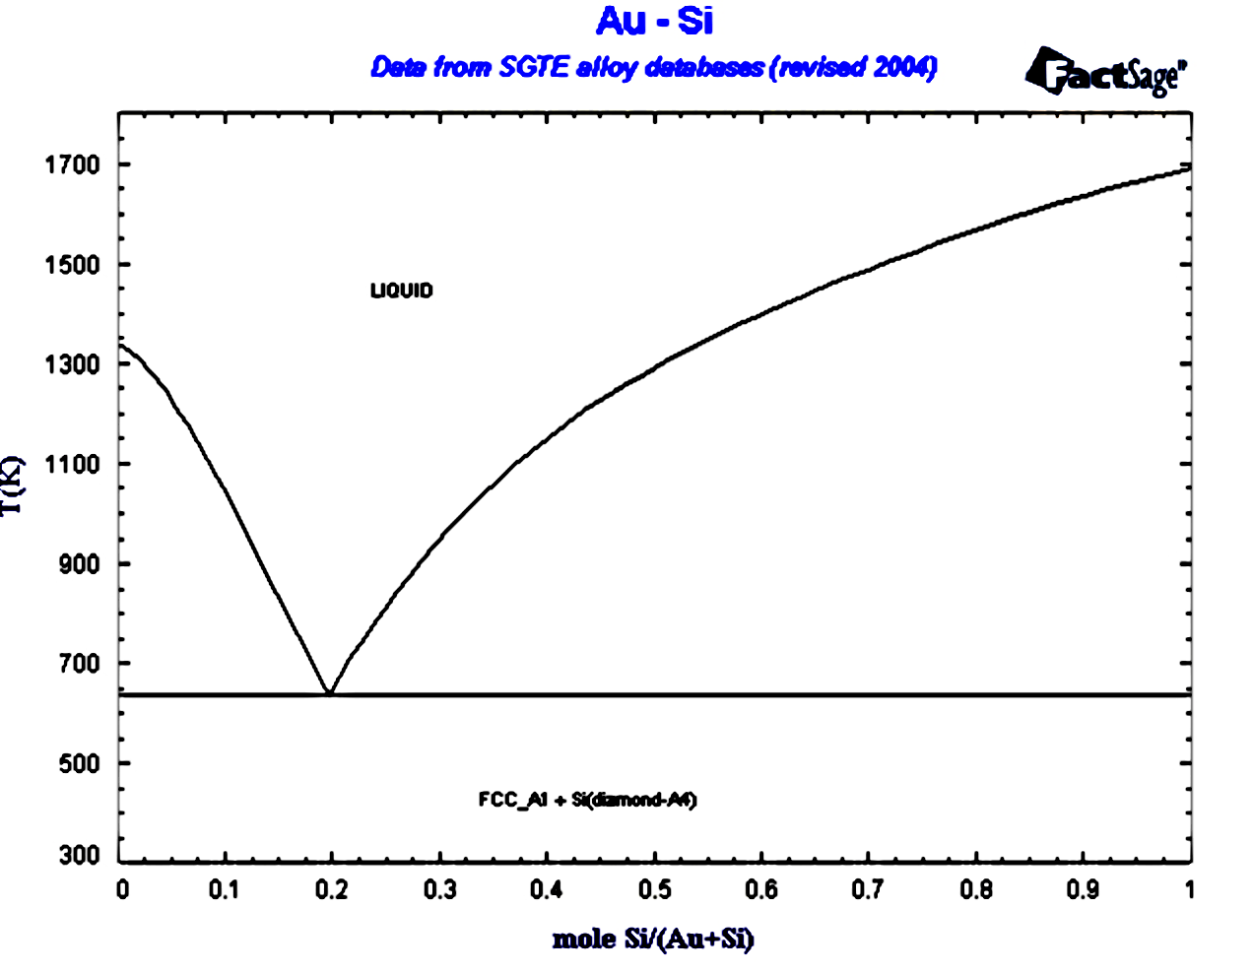
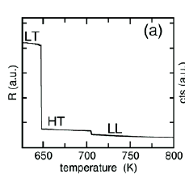
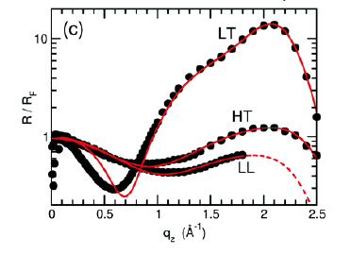
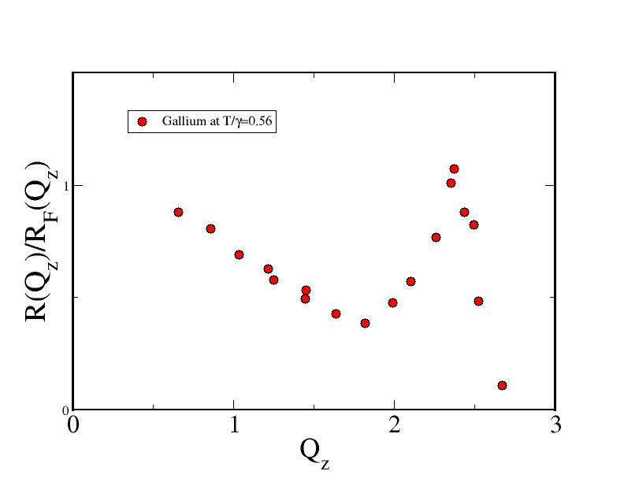
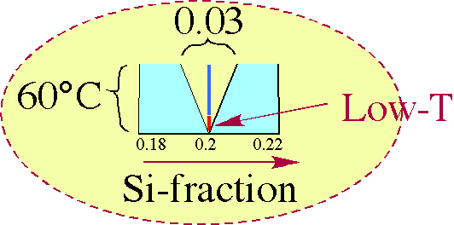
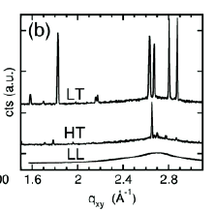

Surface Freezing Au₈₂Si₁₈Eutectic
T/γ~0.8
Gallium
T/γ~0.56
Si
Au
Mechler (LAMXIV)
2D-Crystal ➔Rigidity
Bragg Peaks
LT: Bilayer Xtal
HT: Monolayer
LL: Liquid
Rigidity Reduces Debye-Waller

Slide 19
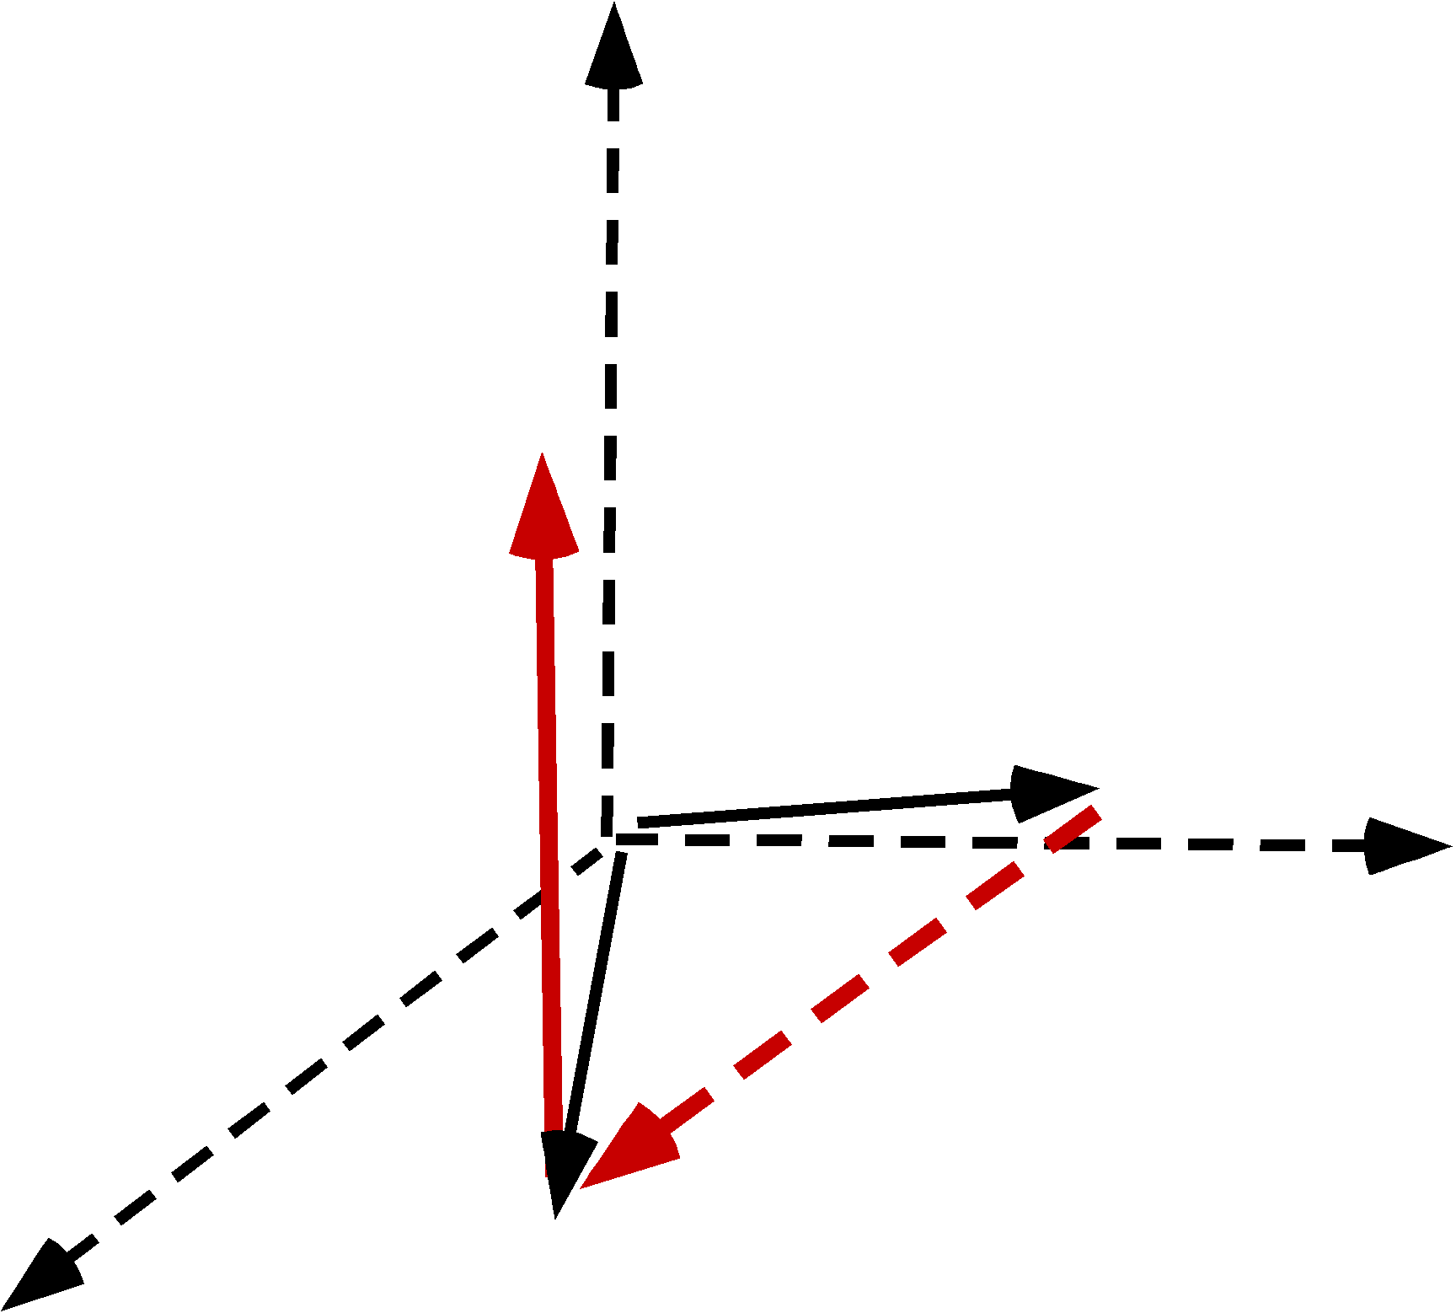
Thickness of the surface crystals
Truncation rod:
Intensity distribution of Bragg reflections along q_{z}
LT
HT
LT: destructive interference → bilayer crystalline phase, d≈ 3.31 Å
HT: atomic monolayer crystalline phase

Slide 20
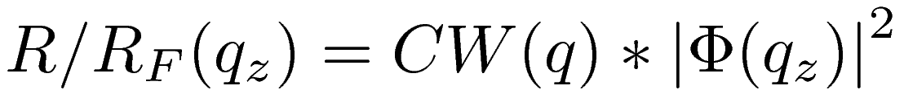





Effect of surface crystals on capillary wave spectrum
Reflectivity of liquid surface:
Structure factor: electron density profile
surface tension
bending rigidity
thermal height-height fluctuations
Diffuse scattering under grazing incidence
For LT surface phase ( ):
Surface crystals exhibit bending rigidity,
Quenching of short wavelength capillary waves
No effect on long wavelength capillary waves
Notes:
Fonts

Slide 21




Self consistent density profile
Constraints for density profiles:
LT: Bilayer and DCM
HT: Monolayer and DCM
LL: Monolayer and DCM, q_{max}
}
+ allow q_{e} to vary
Density profiles
R/R_{F}
LT
HT
LL
Bending rigidity essential for a more physical picture of surface structure
LT:
for HT, LT and LL
HT:

Slide 22




AuGe Eutectic(Should be Similar to Au-Si)
 | γ(Au)/γ(Si or Ge) | ΔH
Au₇₂Ge₂₈ | 1100/621=1.77 | -21
Au₈₂Si₁₈ | 1100/865=1.27 | -30
Au-Si
Au-Si
Au-Ge
2D GID Scans
Au-Ge is Different from Au-Si
No Surface Freezing
• Why?
Pasturel et al. Structure- Liquid Au-Si - molecular dynamics. PRB (2010)
Surface Frozen Ge≤6.5 atm%
Upmanyu et al. (in preparation): NE
Sub surface Si enrichment!
Si (Surface) (Au-Si) (bonding)

Slide 23




Surface Freezing of Au₈₂Si₁₈ and Glass Forming!
Au-Si
Au-Ge
Glass Former
Not A Glass Former
Pd-Si
Pd-Ge
Glass Former
Glass Former

Slide 24




Surface freezing in liquid Au-Cu-Si-Ag-Pd
Trunc. Rod @ 1.65 Å⁻¹
Cooling
GID
R/Rf
@1.4 Å⁻¹
LT (694K)
Heating
Heating
LL (704K)
GID
Lattice: single hexagonal layer (a= 4.4Å)
Superstructure ?
2D crystalline monolayer on the liquid surface !

Slide 25
Summary
Elemental metals ➔Surface induced layering.
Simplest Distorted Crystal Model (Ga,In, K)
Debye-Waller Effects of Thermal Capillary Waves
Near surface deviations from DCM (Sn, Bi).
Other Metal/Vapor Interfaces
2 Phase Binary Alloys (Ga-Bi, Ga-Pb, Ga-Tl)➔
Gibbs Adsorption, Wetting, 2D Crystals
Unexplained behavior of Au₈₂Si₁₈
Eutectic 2D Surface phase transitions for Au-Si
New Results I: Au-Cu-Si-Ag-Pd:
New Results II: Liquid Ge: No Layering

