Slide 1
Liquid Metal Surfaces
P. S. Pershan
SEAS & Dept of Physics, Harvard Univ., Cambridge, MA, USA
Colleagues
Balagurusamy, V. S. K. Berman, E. Deutsch, M. DiMasi, E. Fukuto, M. Gebhardt , J. Gog, T. Graber, T. Grigoriev, A. | Huber, P. Kawamoto, E. H. Kuzmenko, I. Lin, B. H. Magnussen, O. M. Mechler, S. Meron, M. Ocko, B. M. Pontoni, D. | Regan, M. J. Sellner, S. Shpyrko, O. G. Steimer, C. Stoltz, S. Streitel, R. Tostmann, H. Yahel, E
Harvard, Non-Harvard, Beam Line(Current)

Slide 2
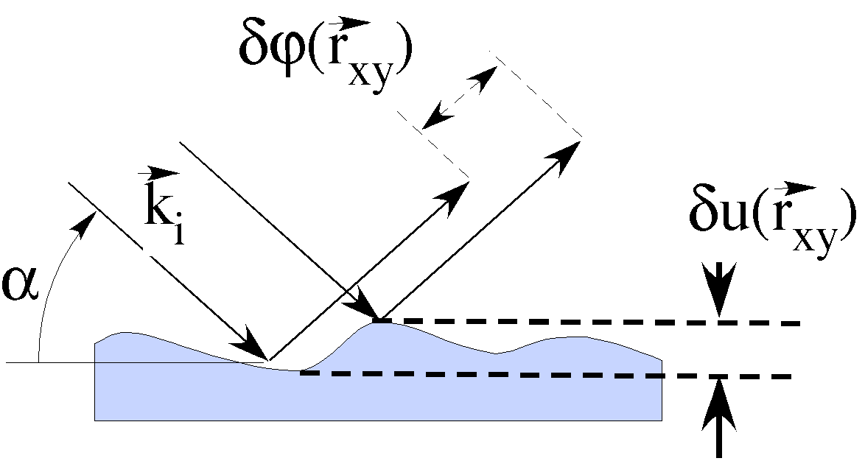
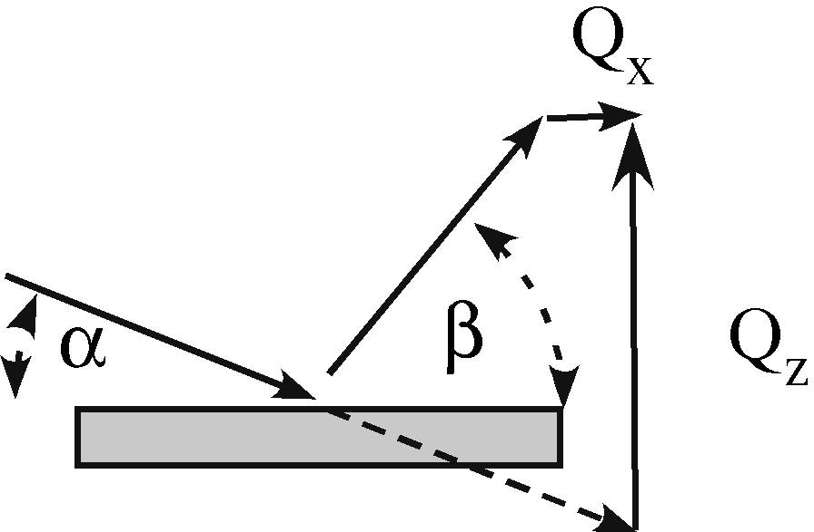
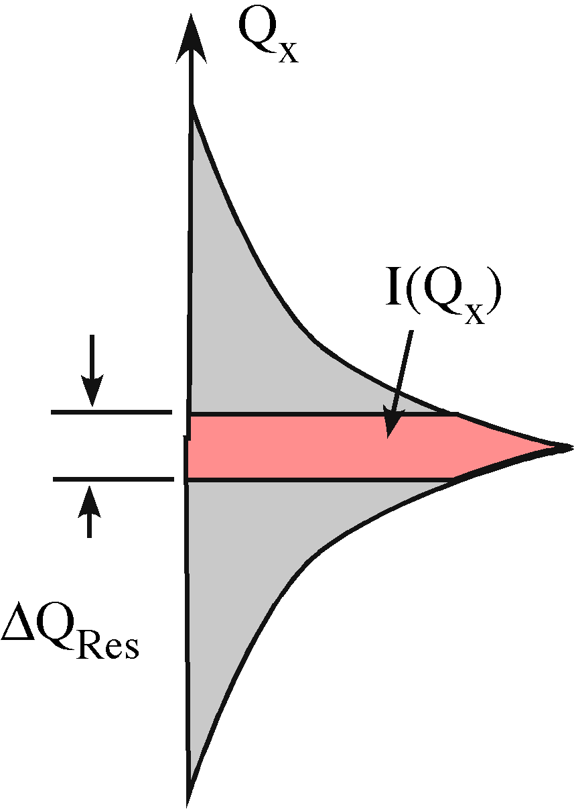
Liquid Surfaces
Debye-Waller

Slide 3
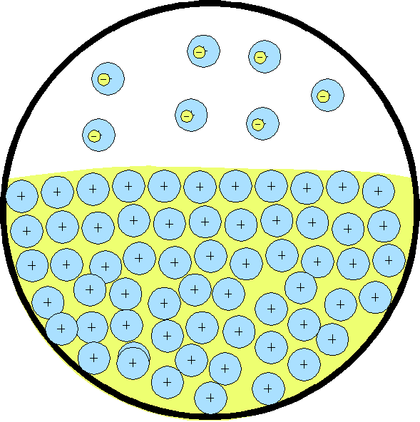
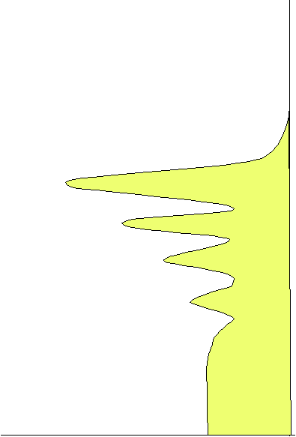
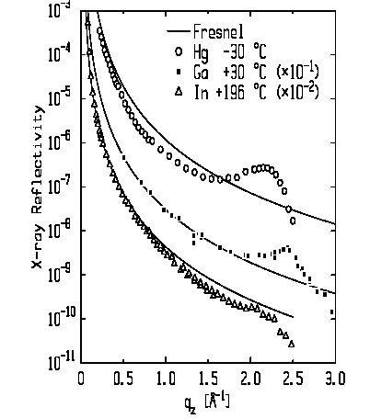
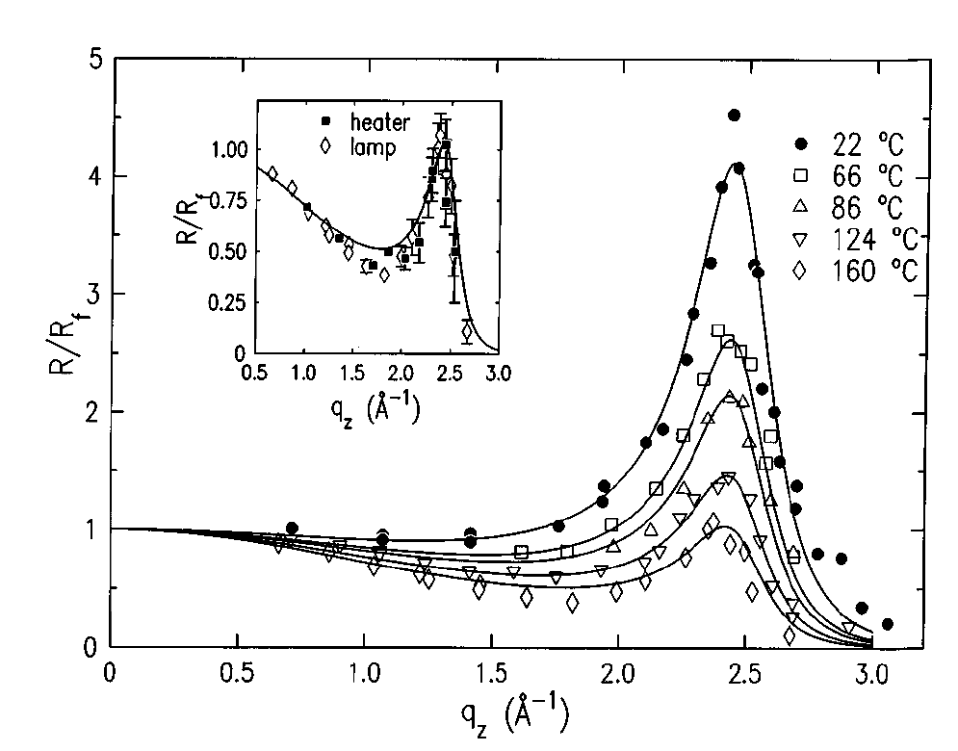
Free Surface of Liquid Metal: Hard Wall
Metallic Liquids (D’Evelyn & Rice ‘83)
Hg. Magnussen et al. (1995).
Ga Regan et al.(1995).
Atoms
⬇
Layers
Hg
Ions in
Fermi Sea
Ga
In

Slide 4
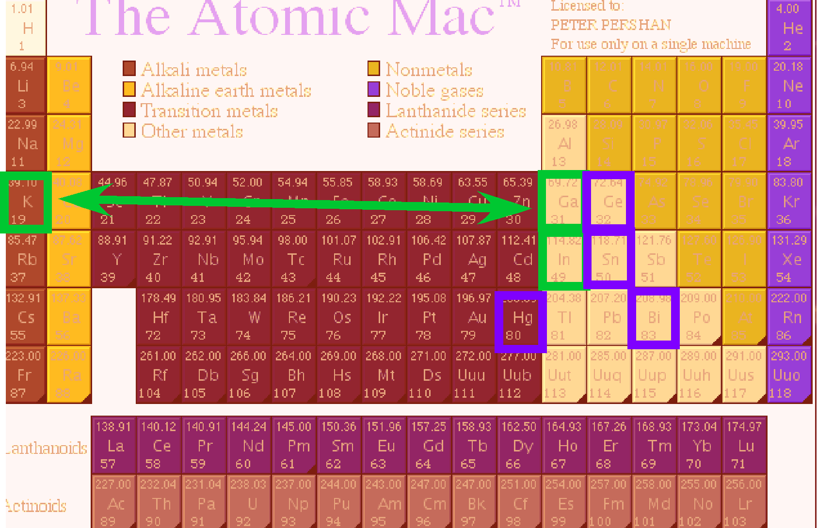
Elements Studied
Type I
Type II

Slide 5
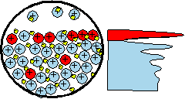
Eutectic Alloys
J. W. Gibbs ~1920
Surface Adsorption: A/B Alloy
If Surface Tension: γ_{A} > γ_{B} Surface is Rich in “B”.
A_{x}B_{1-x} | γ(A)/γ(B) | ΔH* (mixing) | Concentration of Surface Layers
 |  |  | 1st | 2nd | 34d
Ga_{x}Bi_{1-x} | 718/378=1.90 | +4 | Liquid-Liquid Phase Sep.
Ga_{83.5}In_{16.5} | 718/556=1.29 | +5 | 97%In
In₇₈Bi₂₂ | 556/378=1.47 | -1 | 35%Bi
Sn₅₇Bi₄₃ | 560/378=1.48 | +1 | 96%Bi | 25%Bi | 53%Bi
Au₇₁Sn₂₉ | 1100/560=1.96 | -10 | 96%Sn | <1%Sn | 24%Sn
Au₇₂Ge₂₈ | 1100/621=1.77 | -21 | No Gibbs Absorption
Au₈₂Si₁₈ | 1100/865=1.27 | -30 | 4-layers, 2DXtal (AuSi₂)
Pd₈₁Ge₁₉ | 1500/621=2.4 | -44 | ~40 Å wetting layer (No Measureable Gibbs Absorption)
*(kJ/mol)Takeuchi and Inoue, Mater. Trans. 46 (2005)

Slide 6
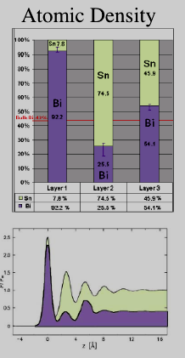
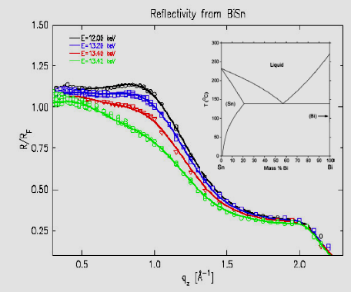
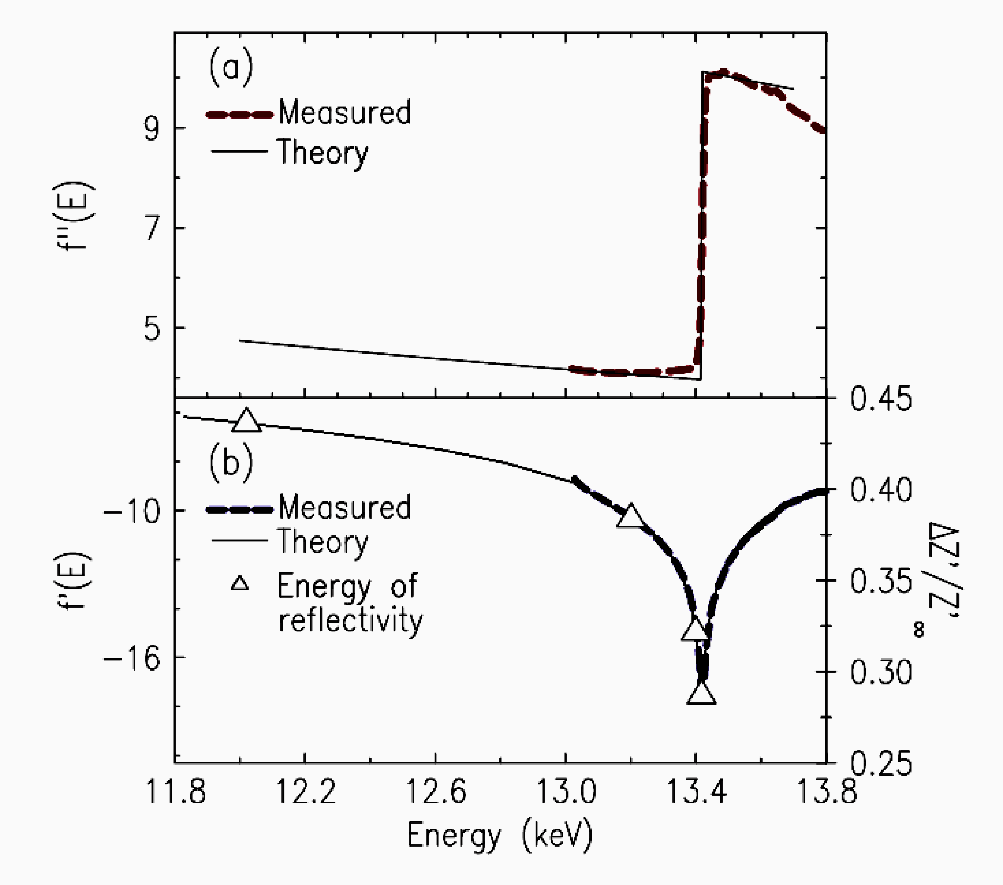
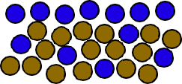
Gibbs Surface Adsorption(BiSn)
Alloy: Bi and Sn
γ_{Bi}=378, γ_{Sn}=560,
Energy Dispersion: f(E)
Adsorption
Scat. Ampl.
γ(Bi)≈ 398
γ(Sn)≈567 dyne/cm

Slide 7
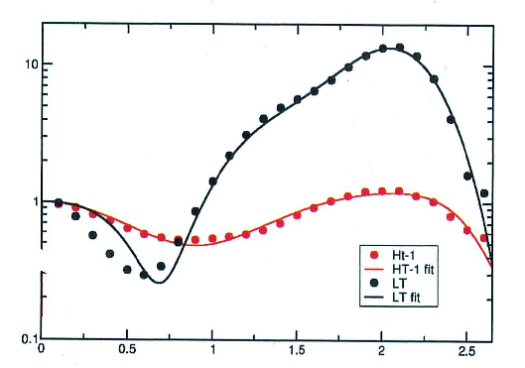
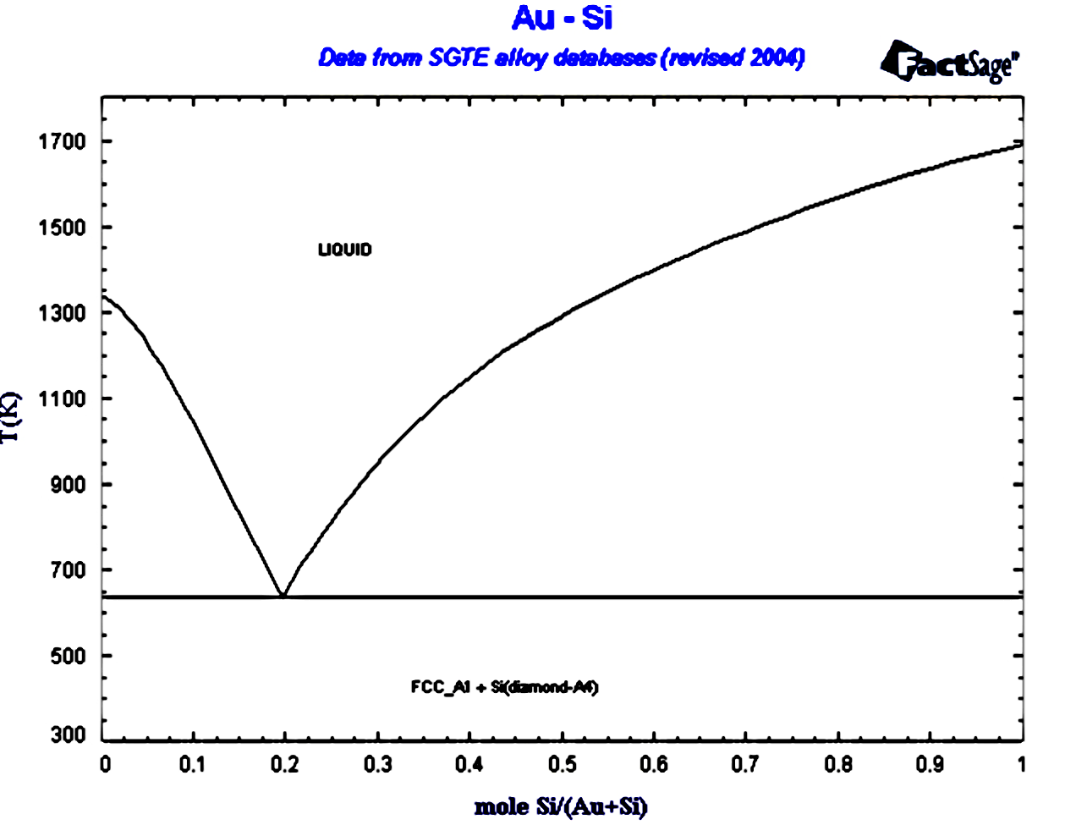
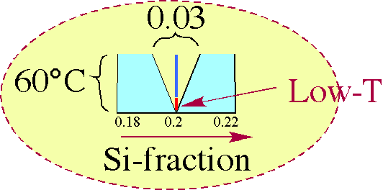
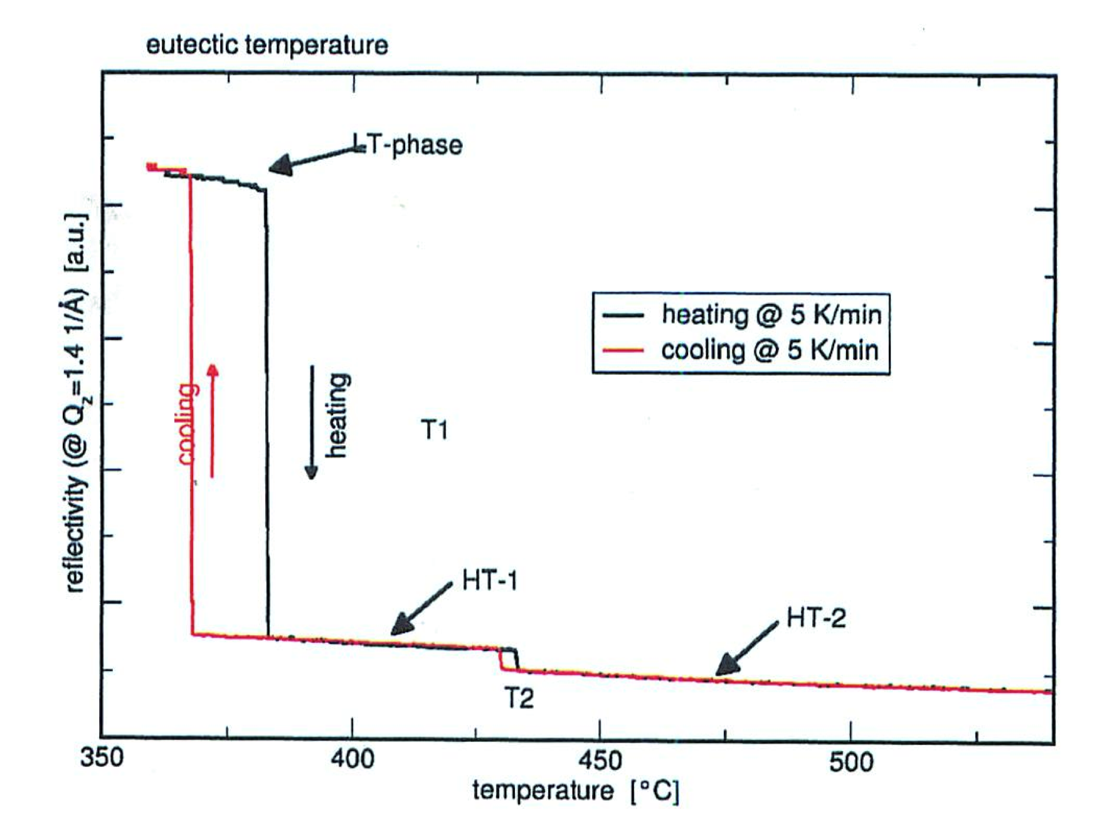
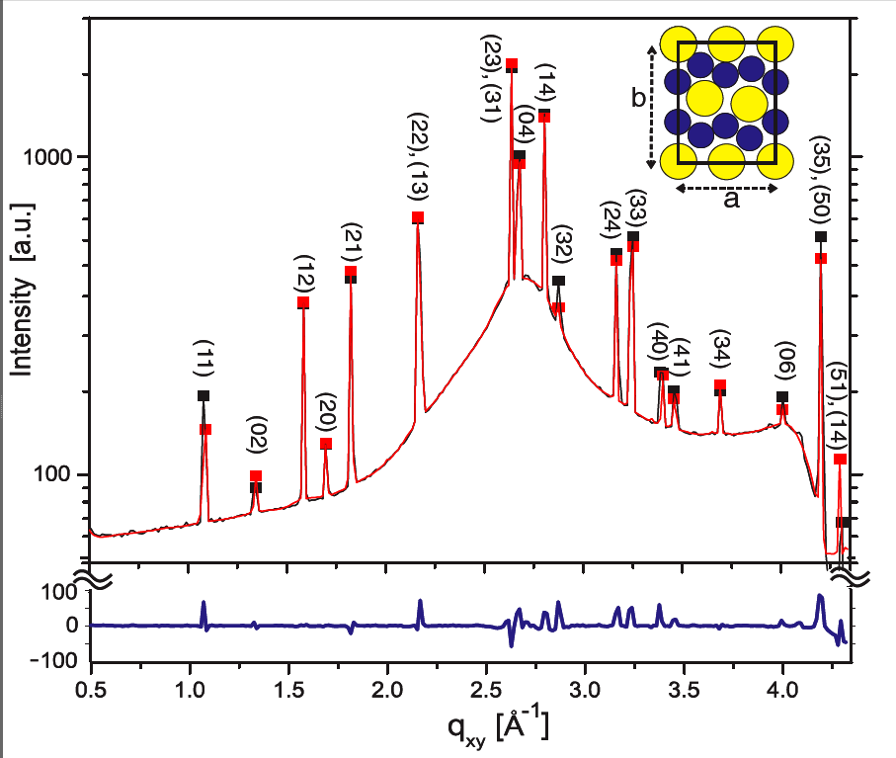
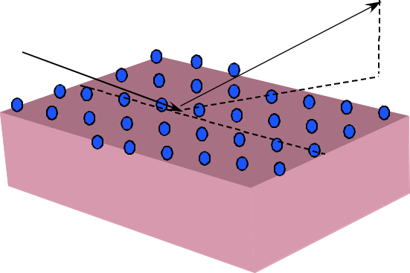
Surface Freezing Au₈₂Si₁₈Eutectic
LT-GID
R(1.4 Å⁻¹)
T
Surface Phases: LT HT1 HT2

Slide 8
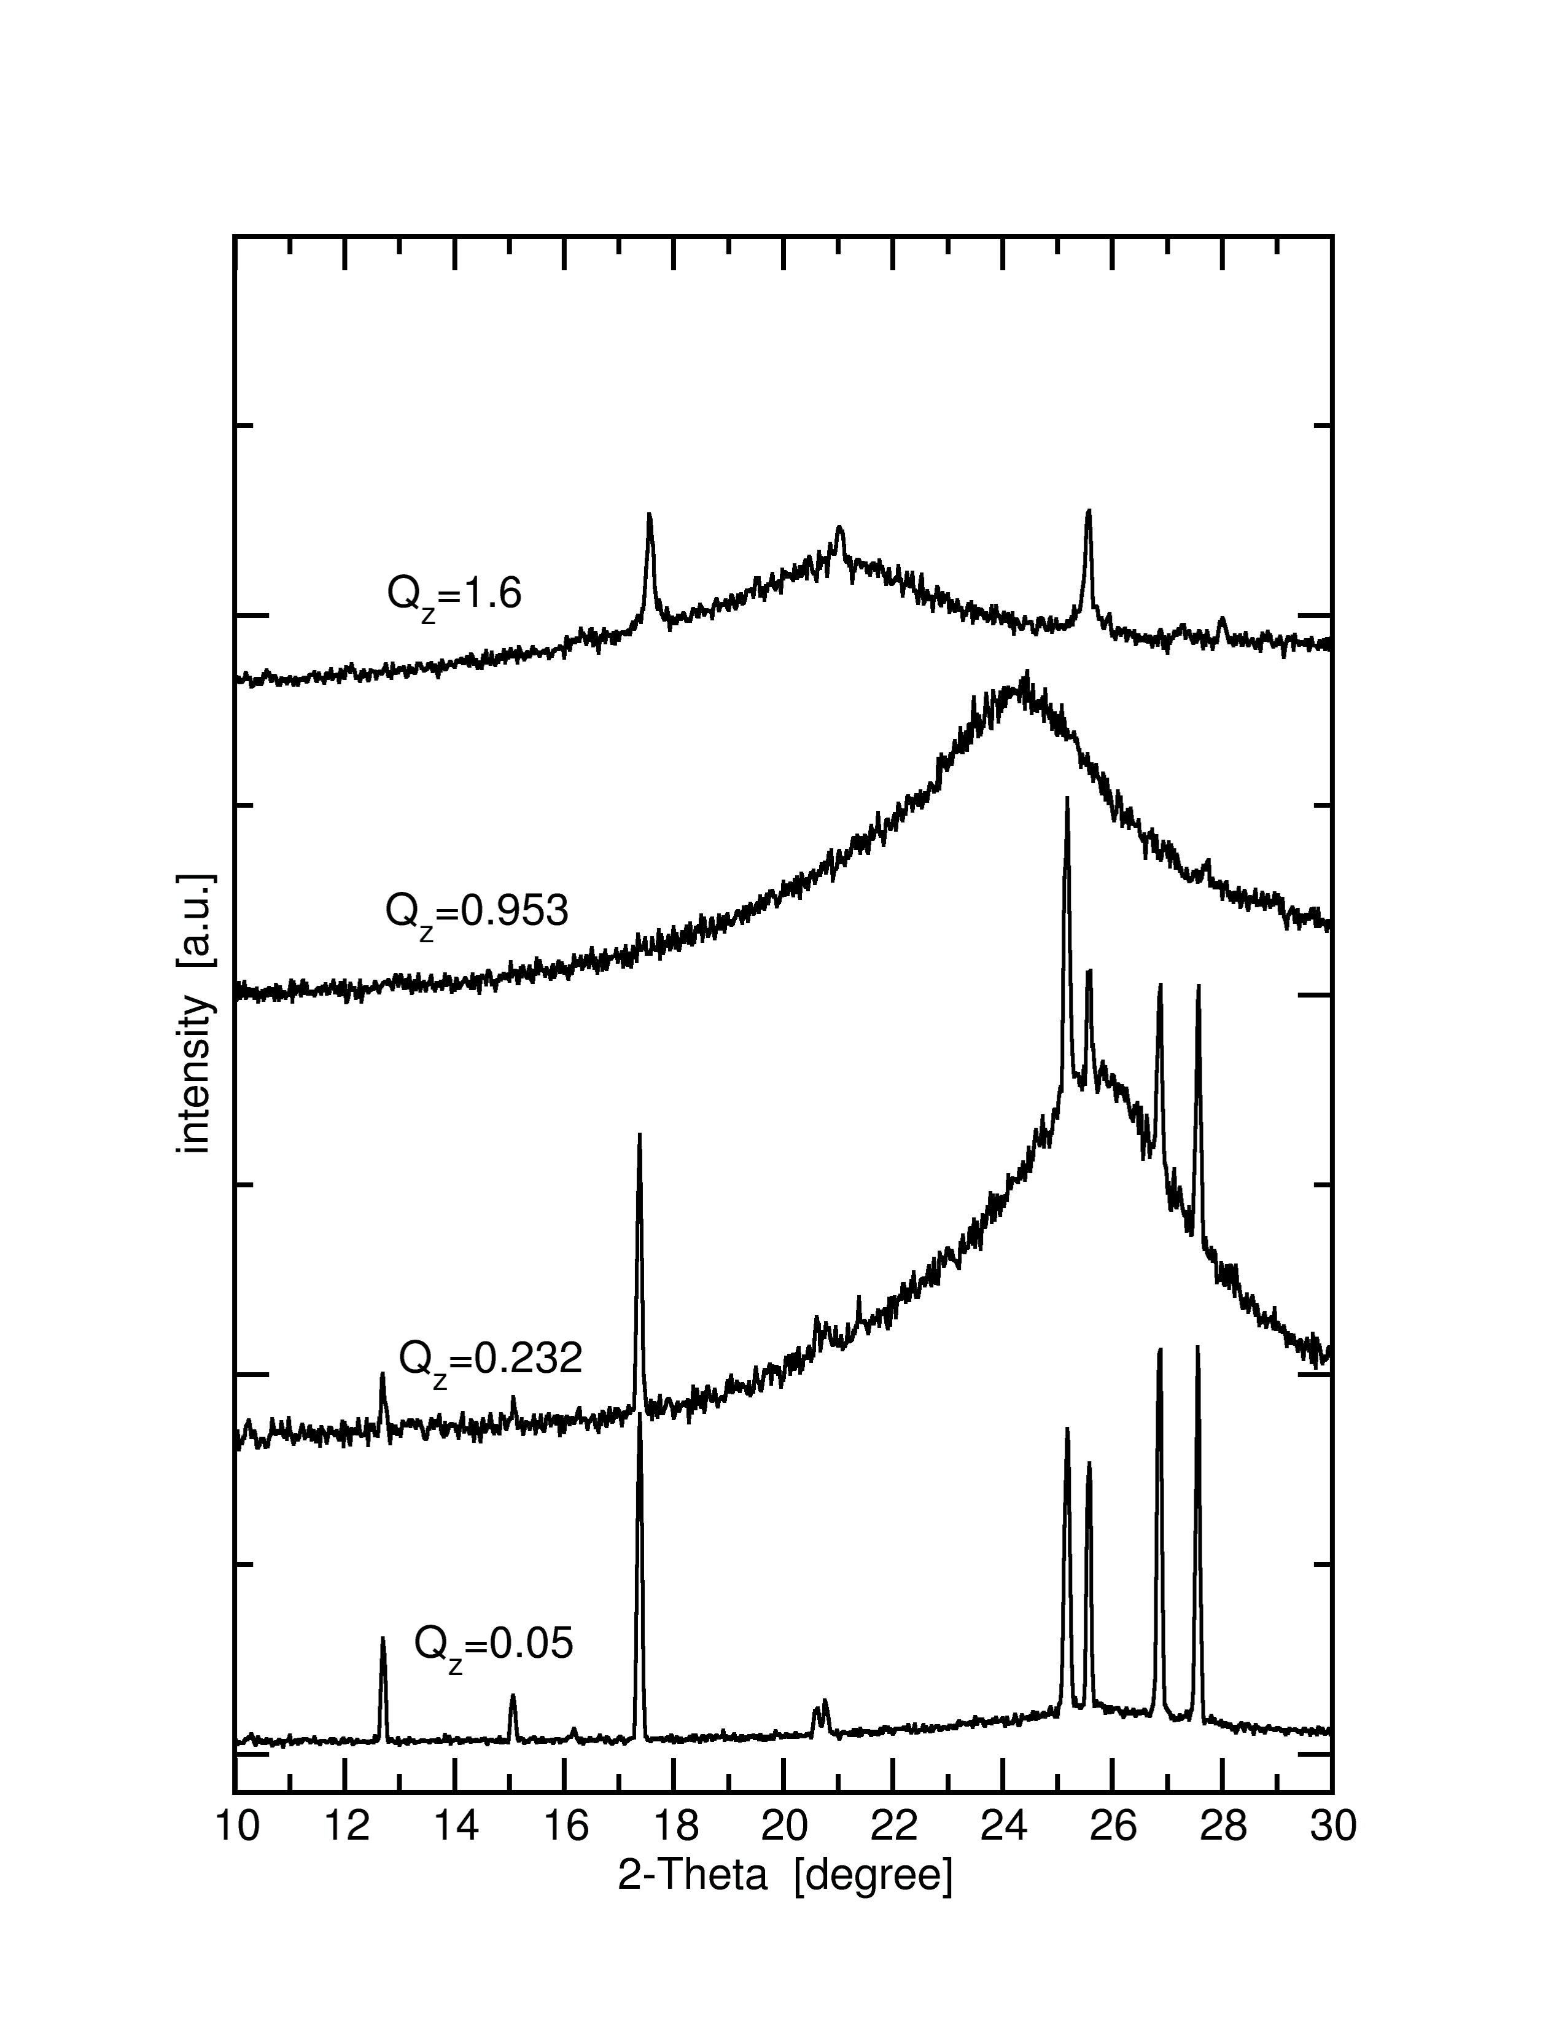
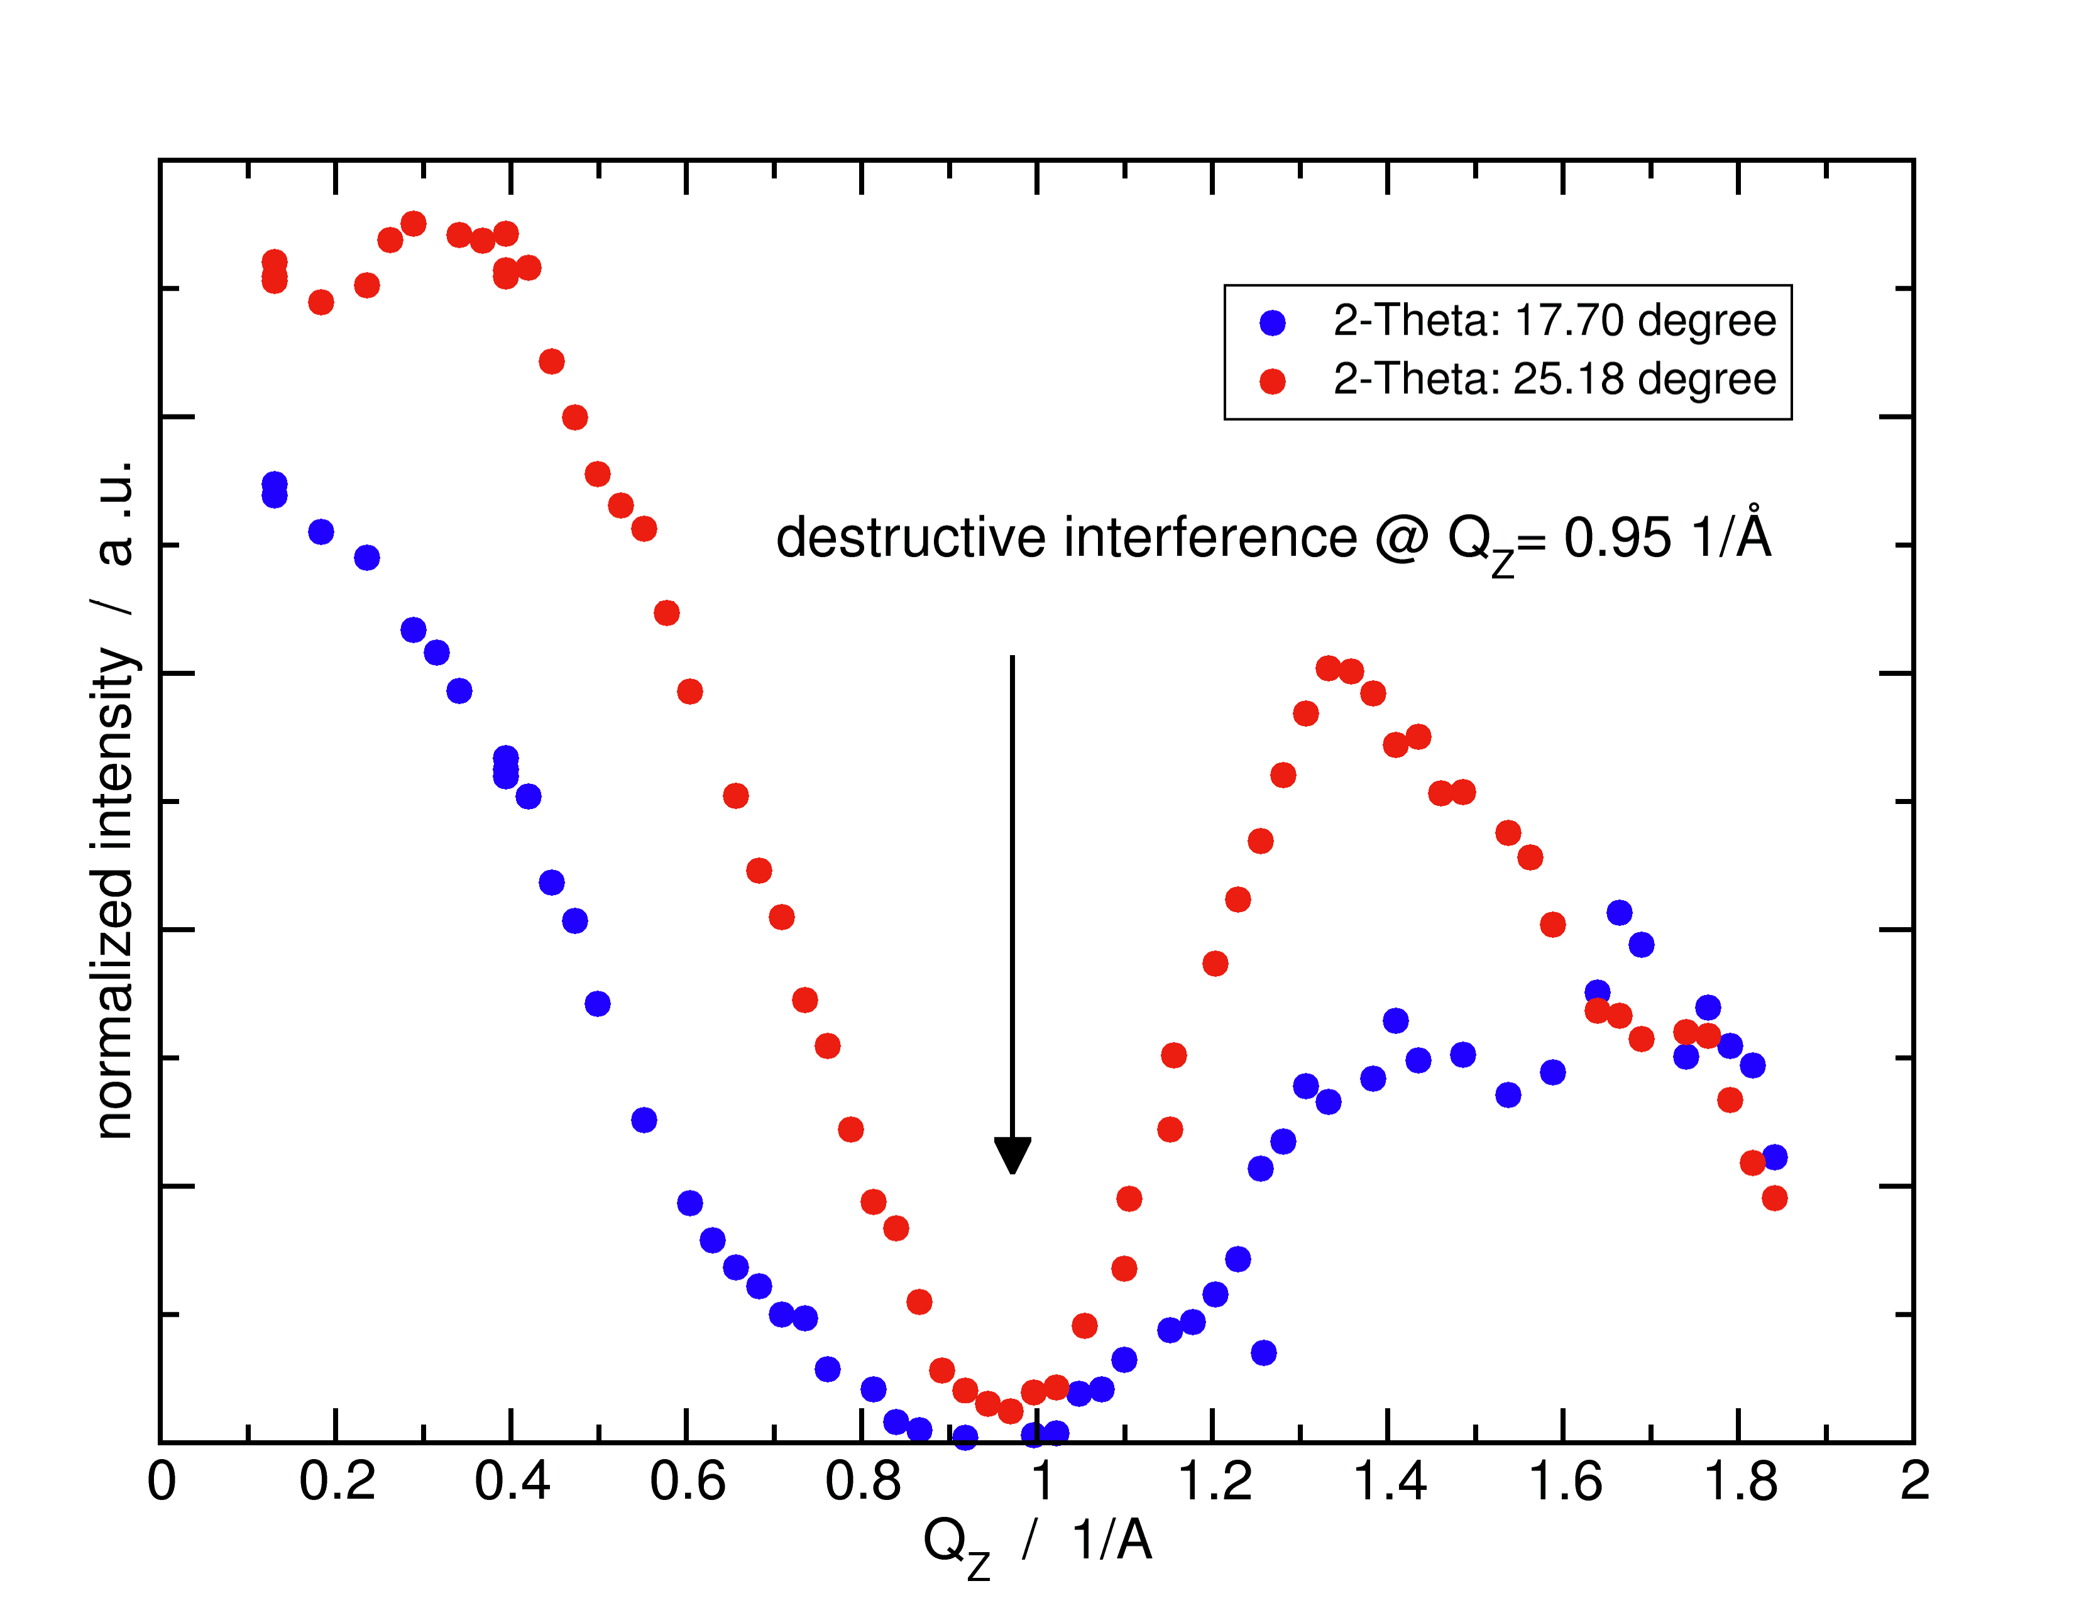
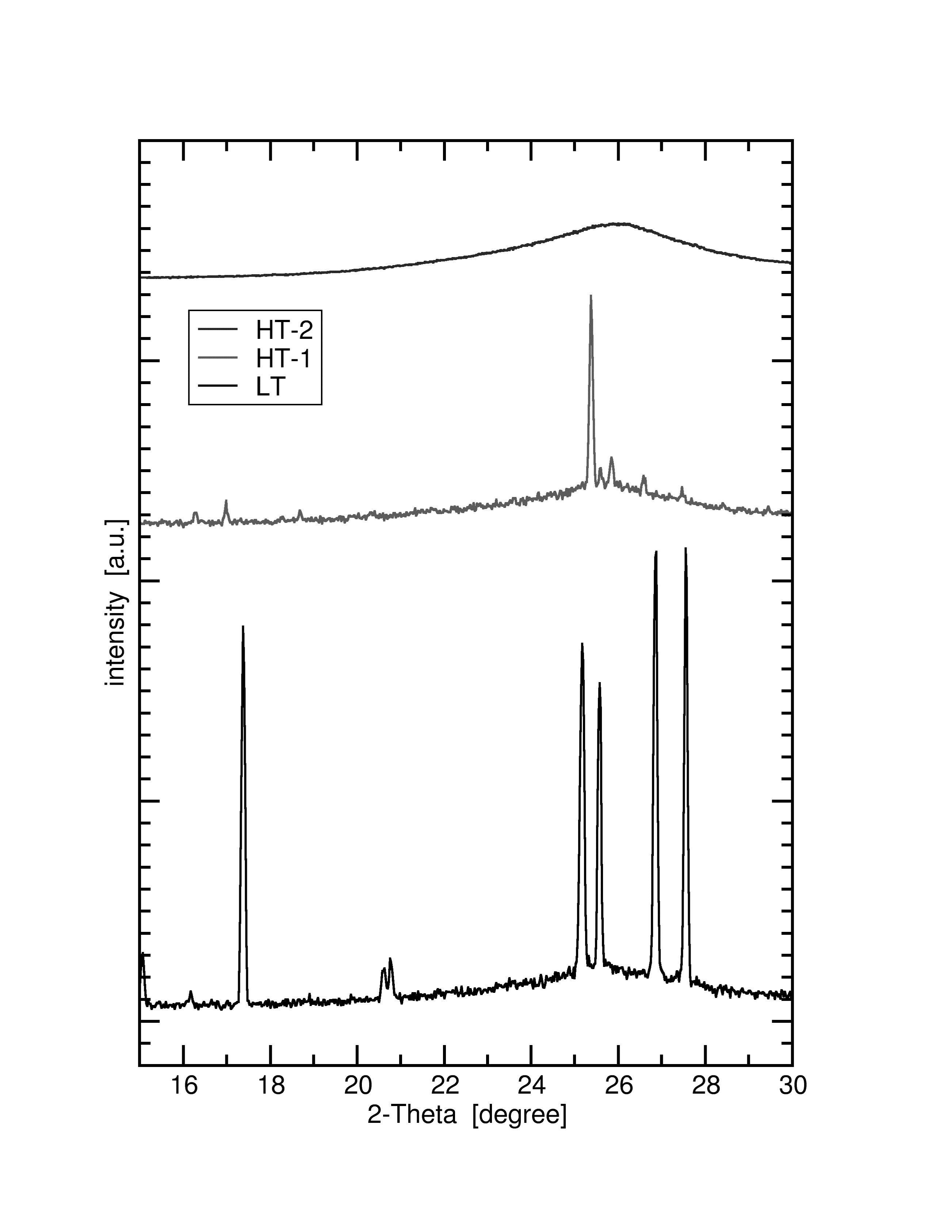
Au₈₂Si₁₈ Truncation Rods
LT Truncation Rod
(Bilayer)
HT2
HT1
LT
Liquid Surface
GID vs T
2D Monolayer
2D Bilayer

Slide 9
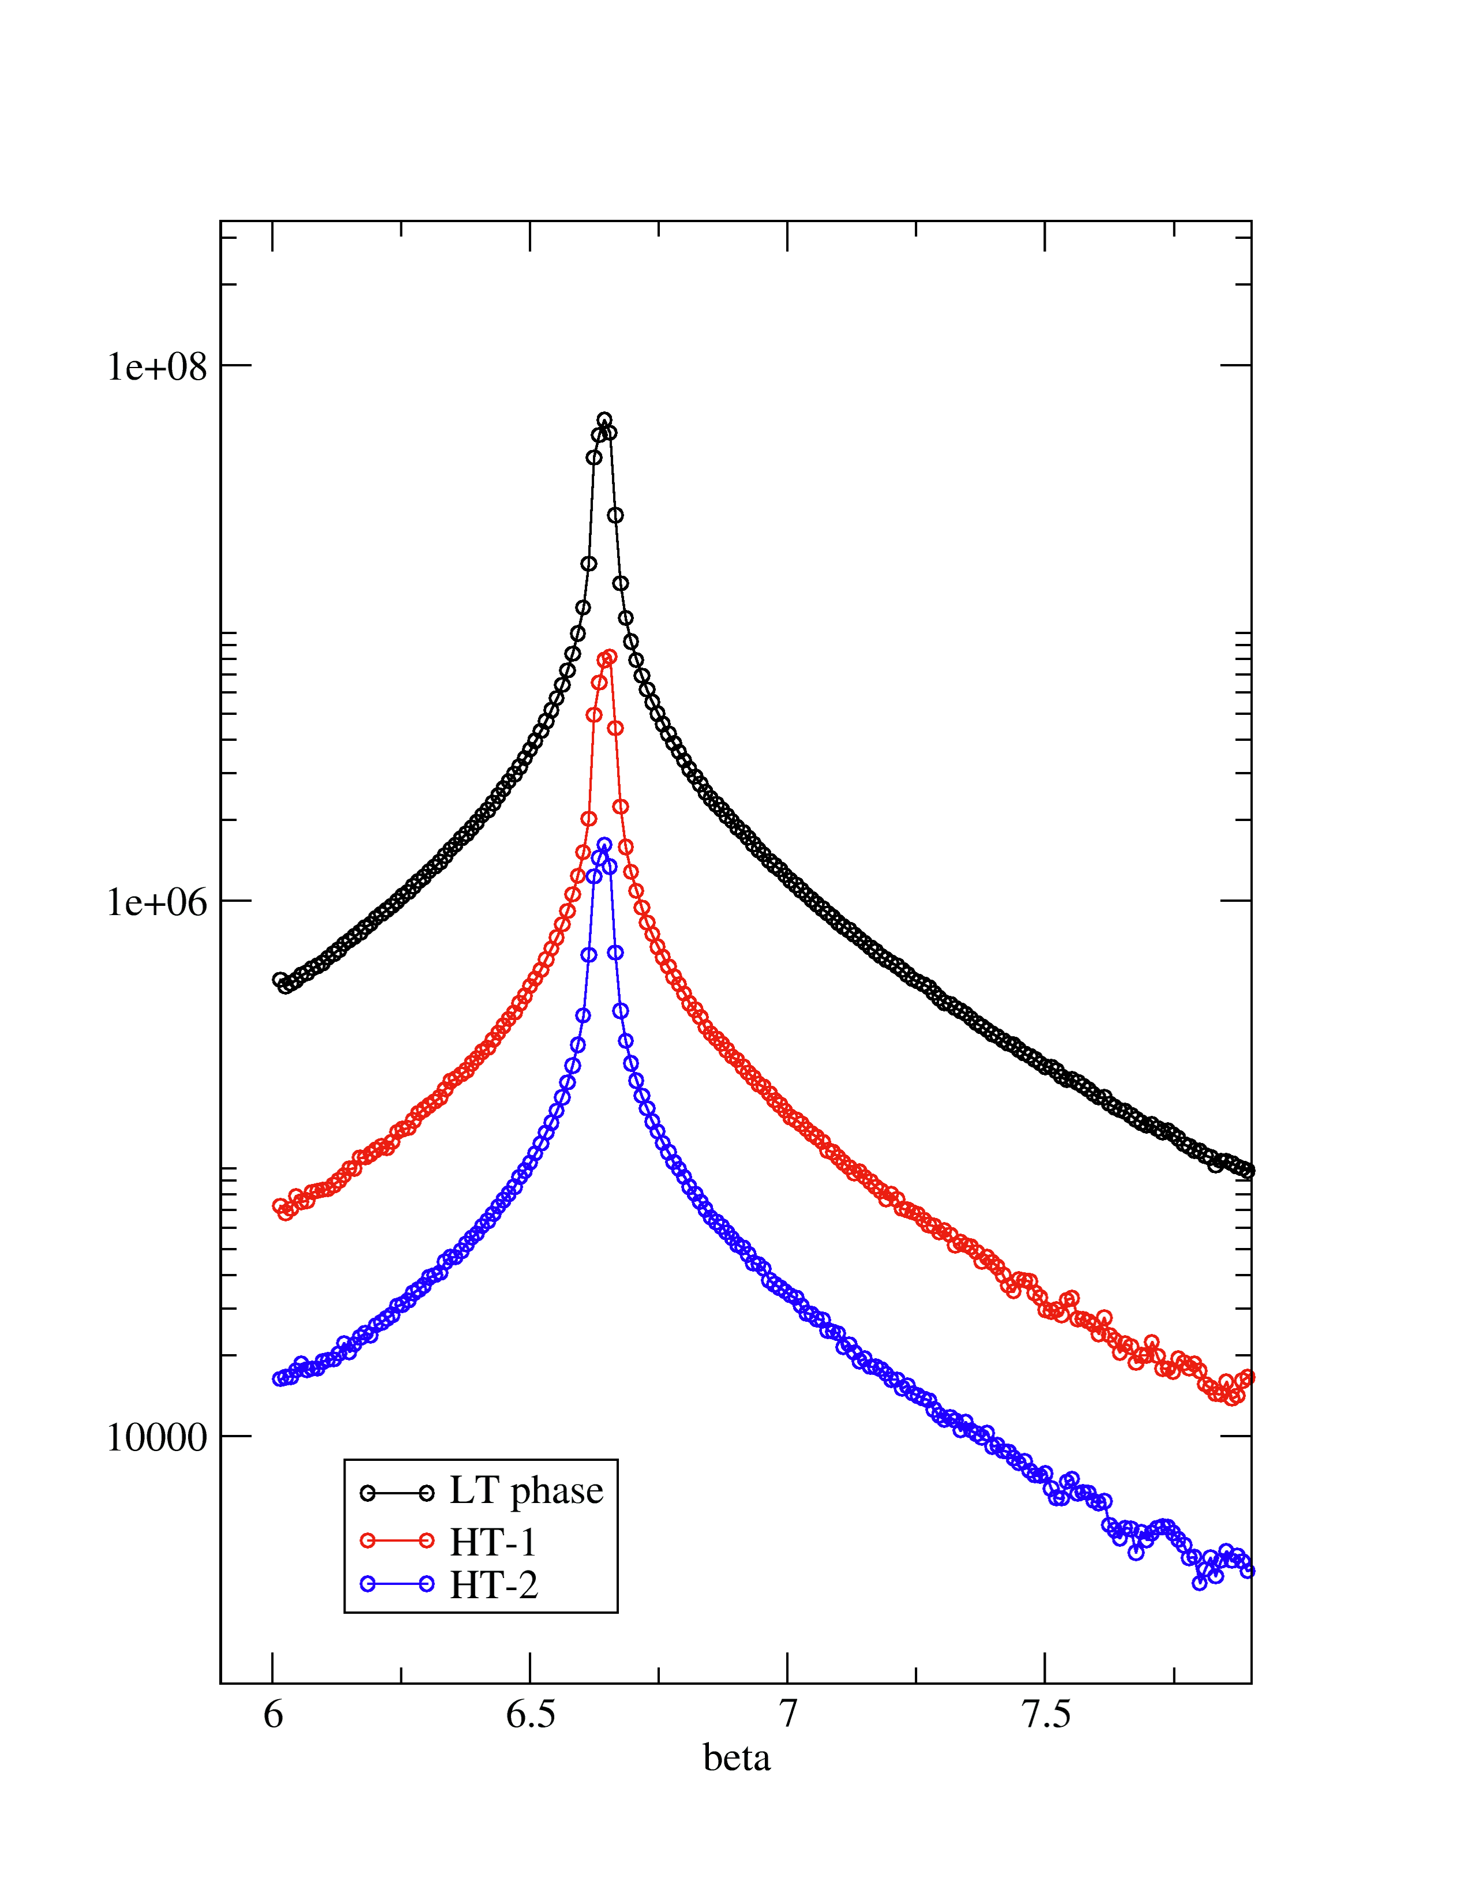
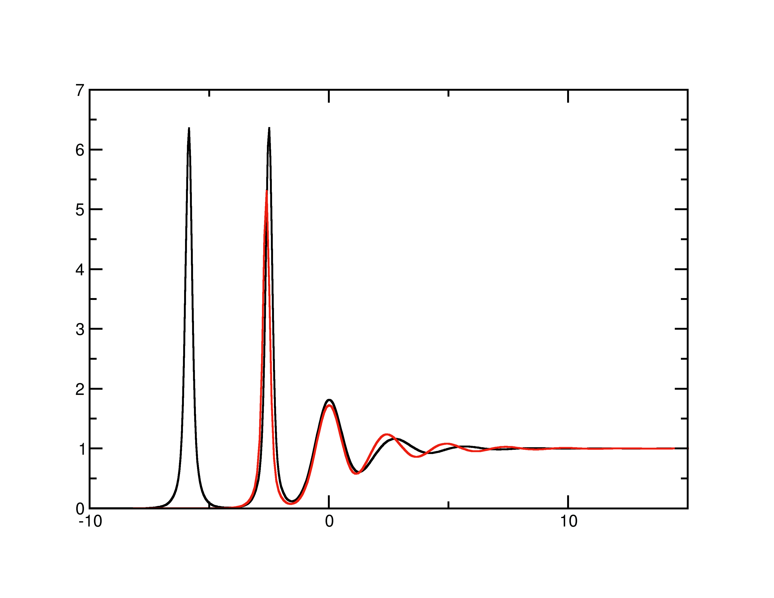
Au₈₂Si₁₈ Interpretation
Best Fits
Diffuse Scattering:
All three phase are liquid
Q_{max} smaller
➔ R(Q_{x}) larger!
λ=1.29Å
α=6.7°
Q_{z}=1.13Å
π/1.44Å ~2.2Å⁻¹
Q_{max}
LT: 0.1Å⁻¹
HT1: 0.5Å⁻¹
HT2: ??
Bi-Layer (LT)
Mono-Layer (HT1)
Q_{x}= 0.012Å⁻¹

Slide 10
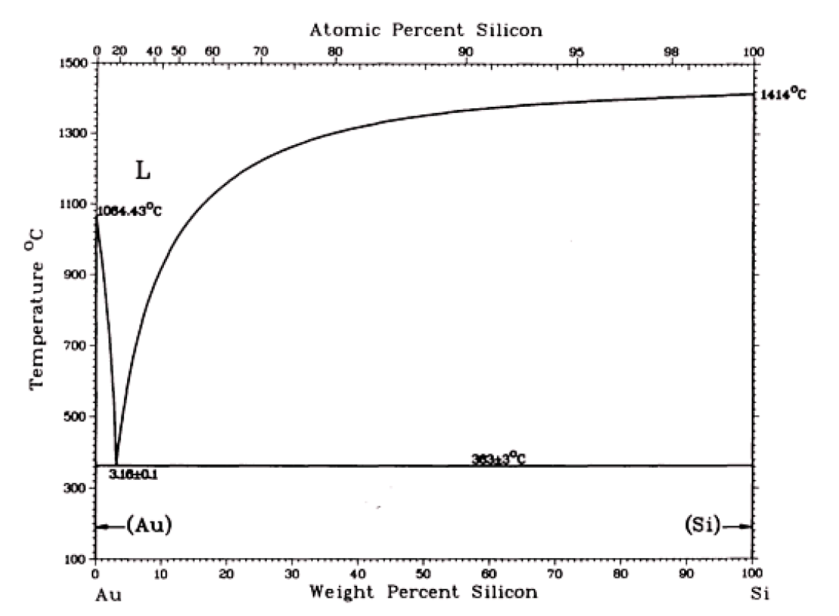
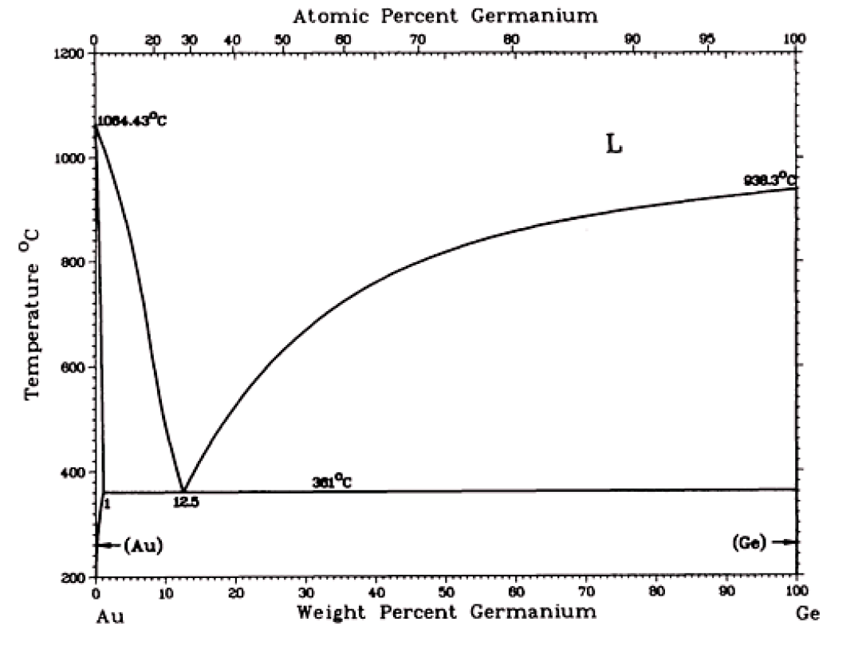
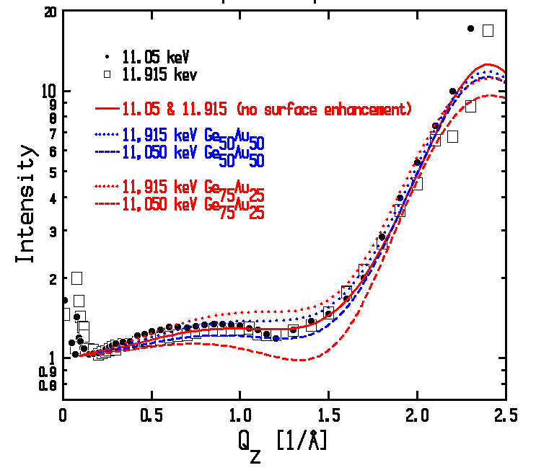
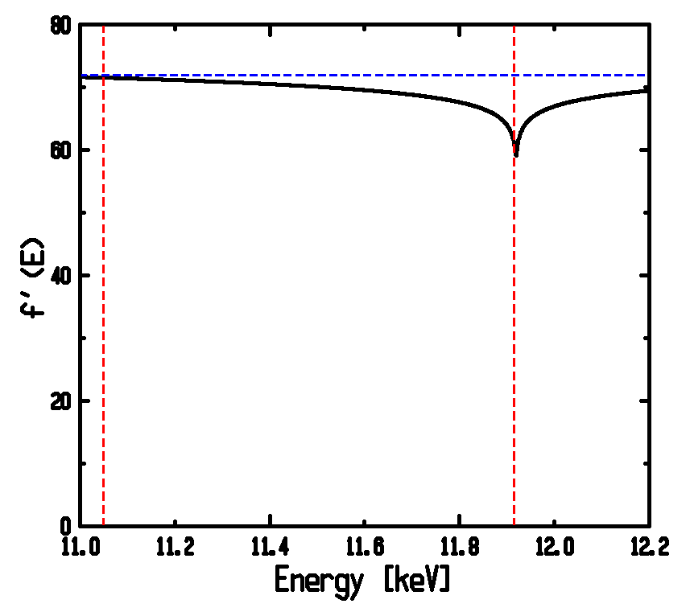
AuGe Eutectic(Should be Similar to Au-Si)
 | γ(Au)/γ(Si or Ge) | ΔH
Au₇₂Ge₂₈ | 1100/621=1.77 | -21
Au₈₂Si₁₈ | 1100/865=1.27 | -30
Au-Si
Au-Si
Au-Ge
f`(E) @AuL3-Edge
Bump➔higher density in 1st layer.
No Energy effect ➔ Ge in 1st layer ≤40atm%.
11.05 kev
×0.82
11.915 kev
Small Gibbs (Different from Au-Sn, etc)!
No Enhanced Layering or 2D order
(Different from Au-Si)!

Slide 11
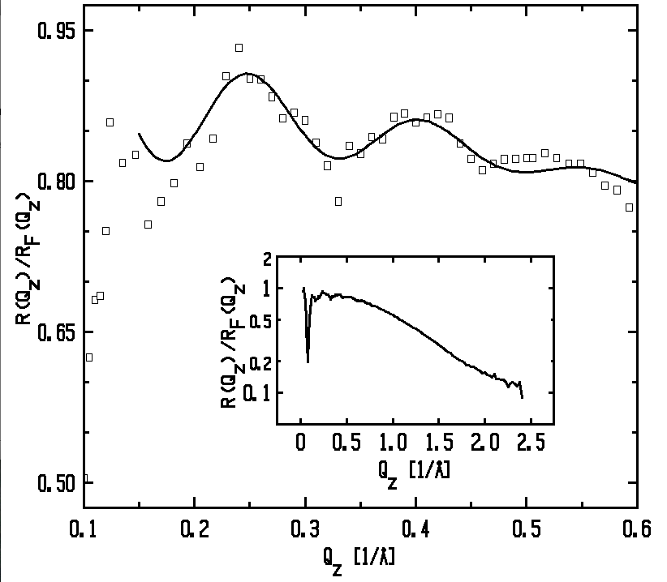
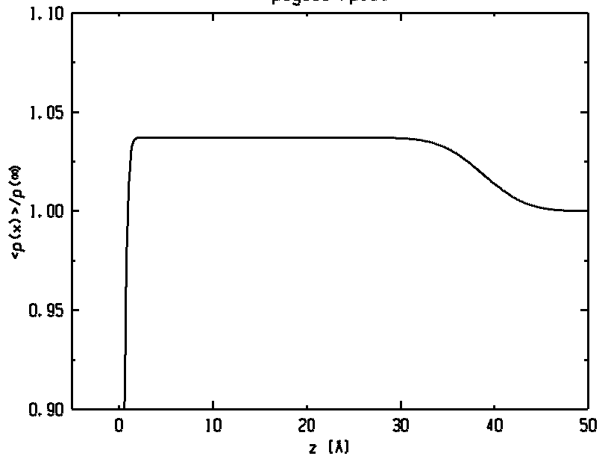
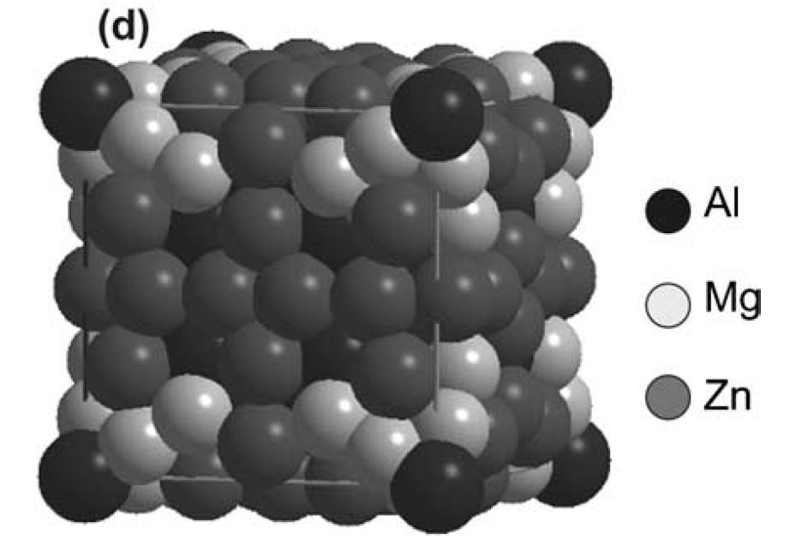
Pd₈₁Ge₁₉(Dec.’08)
 | Au₈₂Si₁₈ | Pd₈₁Ge₁₉
Glass former | yes | better
ΔH | -30 | -44
Expected same 2D surface order for Pd₈₁Ge₁₉ as Au₈₂Si₁₈!
Not found; however, something new! Metallic Clusters (Giant Unit Cells)
Small angle oscillations!
Ref: Urban &Feuerbacher,
J.Non-Crys.Sol.(04)
Quenched Icosahedral Clusters
Preliminary fit.
ρ/ρ∞
~4%
Mg₃₂(Al,Zn)₄₉
14nm
Others: NaCd₂ 30Å
YbCu_{4.5} 44-49Å
Al₃Mg₂ 28Å

Slide 12
Summary
Metal/Vapor Interface➔Atomic Layering:
Surface Structure Factor - Φ(Q_{z}): Measurement affected by thermal roughness. Requires knowledge of surface tension.
Surface tension: measured with diffuse scattering:
Surface tension effect demonstrated for Ga
Alloys: Surface tension vs. Enthalpy of Mixing
Gibbs absorption is not simple. No reliable theory.
Au₈₂Si₁₈ anomalously strong layering and 2D order.
Why are Au₈₂Si_{18,} Au₇₂Ge₂₈ and Pd₈₁Ge₁₉ all different?
Need for THEORY!
New Result (Preliminary):
Surfaces & Icosahedral Metallic Clusters

